Slide 1
Enter Your References

Slide 2
So you’ve created a portfolio, now what?

Slide 3
References
OBTAIN PERMISSION FROM YOUR REFERENCE
Sufficient Contact Information
Variety of Reference Types
Spelling, Punctuation, and Correct Information listed.

Slide 4
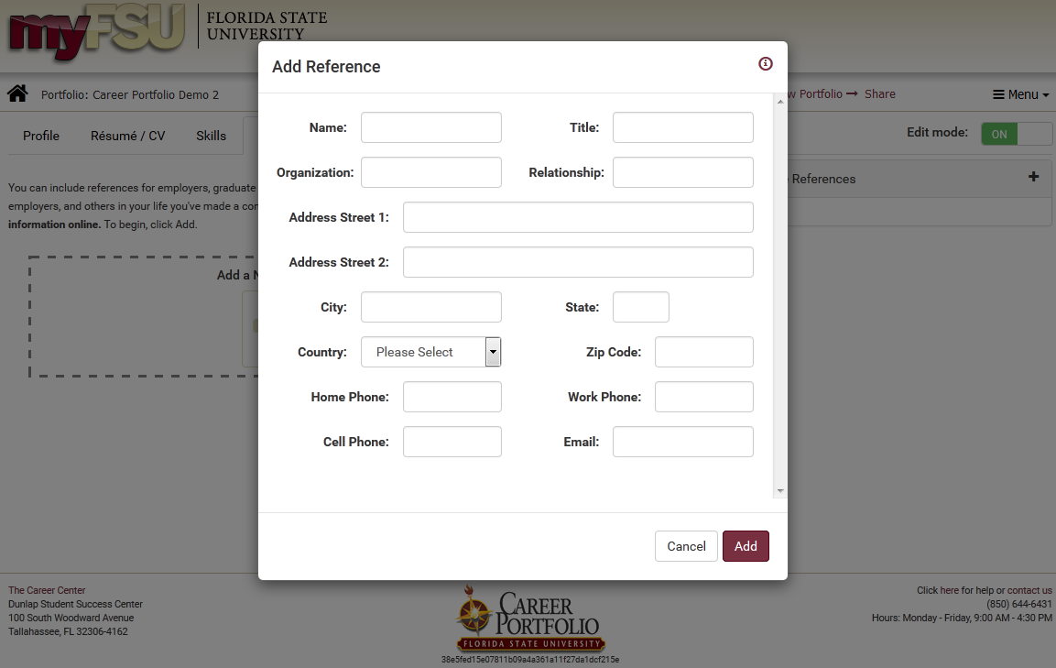

Slide 5
Click and Drag to Reorder

Slide 6
Preview Your Portfolio

Slide 7
Preview Your Portfolio

