Slide 1
Effective Strategies for Integrating Theory, Research & Practice: 30-Years of Successful Collaboration
V. Casey Dozier, Ph.D.
Janet G. Lenz, Ph.D.
James P. Sampson, Jr., Ph.D.
David H. Murphy, M.Ed.
http://career.fsu.edu/tech-center/about-us
Florida State University
National Career Development Association, June 2018
Notes:
All - introductions

Slide 2
Goals
Learn about key elements associated with a university-based successful theory, research, and practice collaboration
Learn about strategies that can help in managing and sustaining theory, research, and practice collaborations over an extended period of time
Understand and anticipate organizational challenges and issues that may impact collaborative efforts
Gain knowledge of specific examples of measurable outcomes and tangible products that can be obtained through these types of collaborative efforts
Notes:
Casey
Goals for today… highlight some of our successful strategies integrating T,R,P
Help you walk away with some tangible outcomes

Slide 3
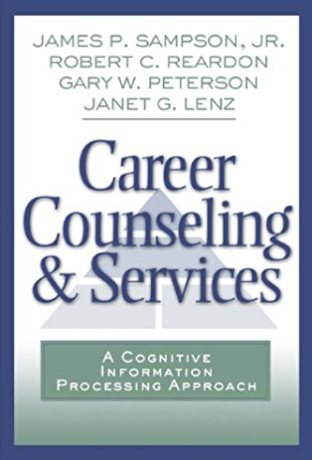
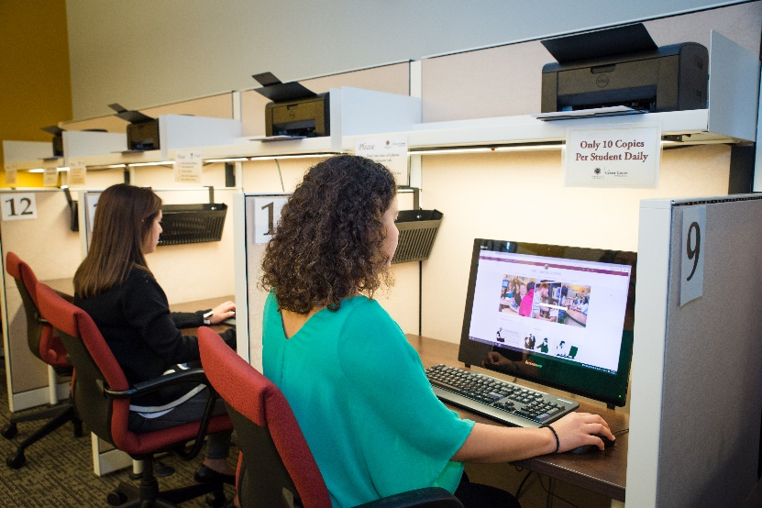
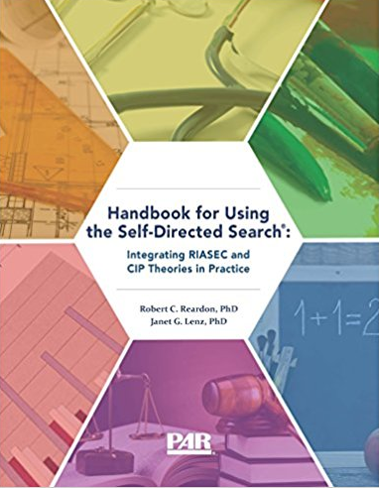
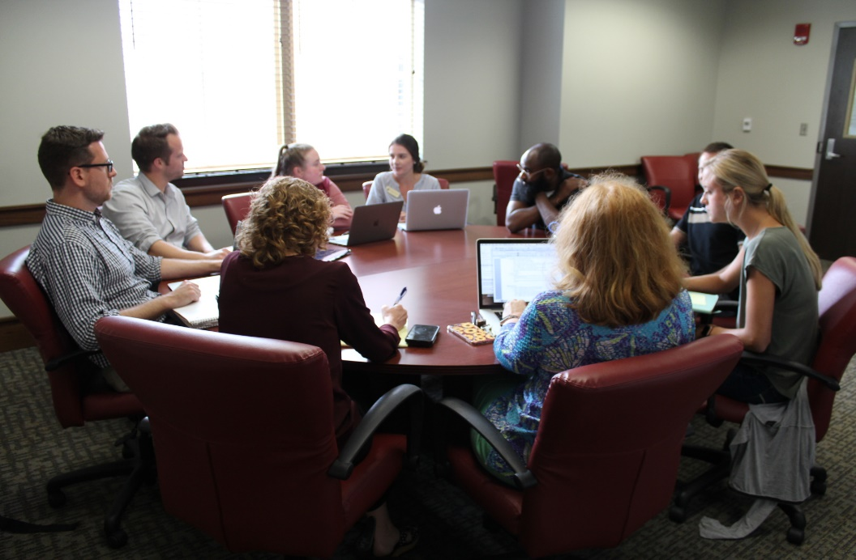
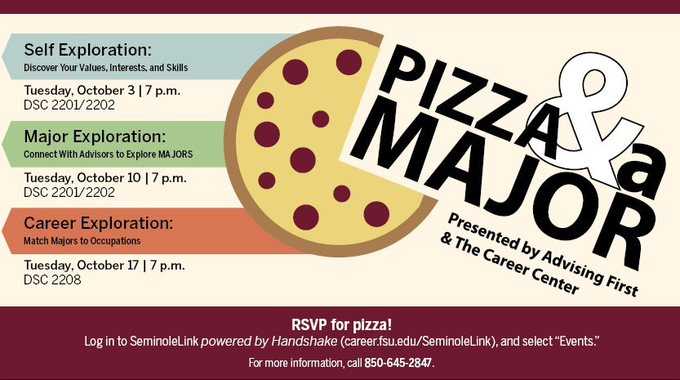
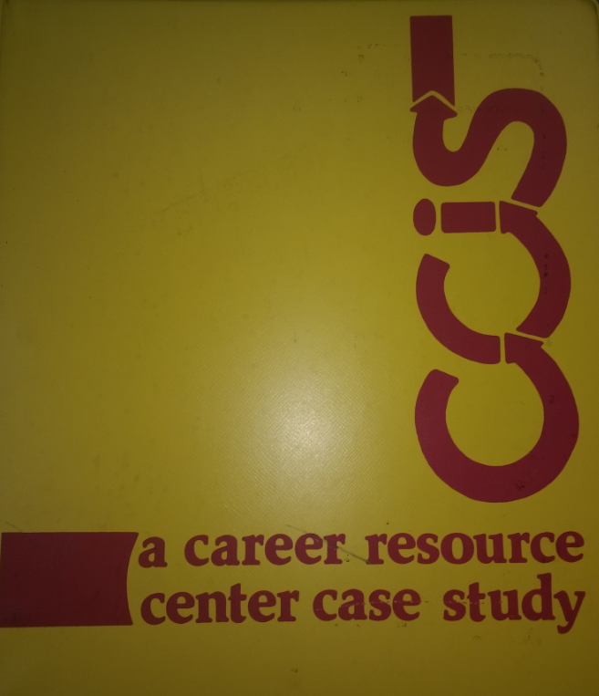
30 Years of Inspiration
Notes:
Casey
FSU – Div. 1 research school; 40,000+ students
Integration of T,R,P can come in many forms
Textbooks
Research groups
Career development course
Hosting a conference
Even workshops – integrate theory – who doesn’t love free pizza?

Slide 4
Integrating Theory, Research, and Practice
Theory guides research by formulating research questions, creating measures, and interpreting the results
Theory guides practice by helping practitioners conceptualize client concerns and deliver interventions, as well as in developing assessments, information, and instruction
Research assists in creating and validating new theory
Research provides an evidence base for practice
Observations from practice support ongoing theory revision and provide evidence to further guide future research
The following Figure depicts potential interactions among theory, research, and practice
Notes:
Jim

Slide 5
Integrating Theory, Research, and Practice
Sampson, J. P., et al. (2014). Annual review: A content analysis of career development theory, research, and practice - 2013. The Career Development Quarterly, 62, 290-326. doi:10.1002/j.2161-0045.2014.00085.x
Notes:
Jim to provide an overview of CIP and how CIP integrates theory, research, and practice
Jim to connect this presentation to the work at the 2016 SVP conference
Probably need to speak directly to current conference theme of transitions and how CIP informs that

Slide 6
Theory, Research, and Practice Integration Example
Development of the Career Thoughts Inventory (https://www.parinc.com/Products/Pkey/73)
Use of Holland’s My Vocational Situation (MVS) in FSU Career Center practice
Development of the cognitive information processing theory of career choice
Observation of negative career thoughts among clients during practice
Research used in CTI development and validation
Practice revised to replace MVS with CTI in individual and group interventions
CIP theory revised to include additional aspects of negative career thoughts based on research
CTI research used to help establish evidence-based practice
Notes:
Jim

Slide 7
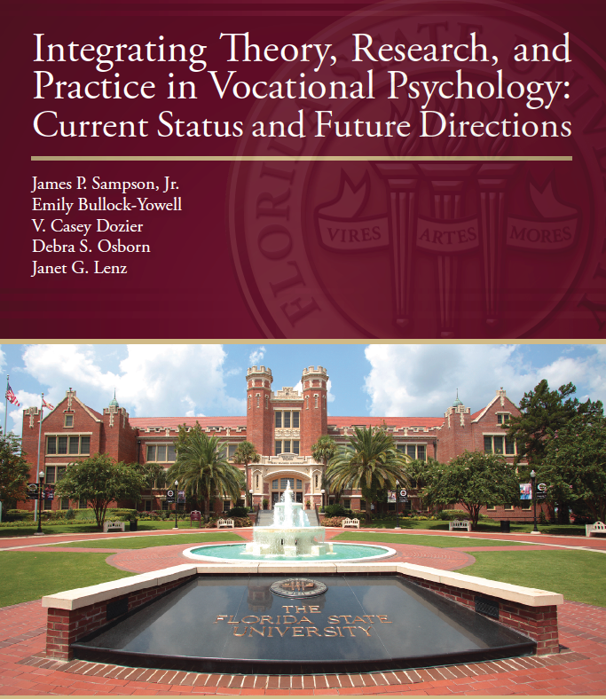
2016 SVP Conference
2016 Society for Vocational Psychology Conference examined challenges and opportunities for integrating theory, research, and practice with input from theorists, researchers, and journal editors (http://journals.fcla.edu/svp2016/index)
Most frequent challenge identified was difficulties in communication among theorists, researchers, and practitioners
Most frequent recommendation for improvement was improved communication among theorists, researchers, and practitioners
Notes:
Jim

Slide 8
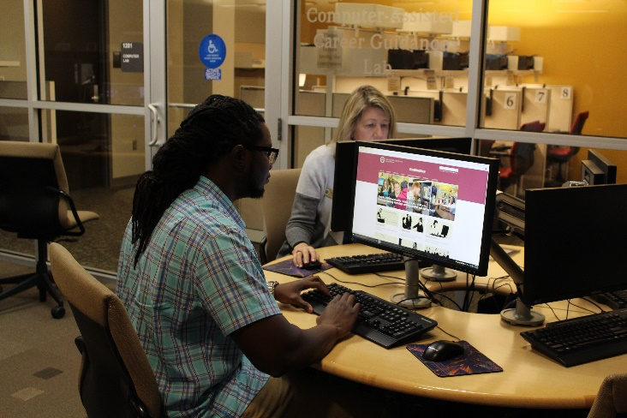
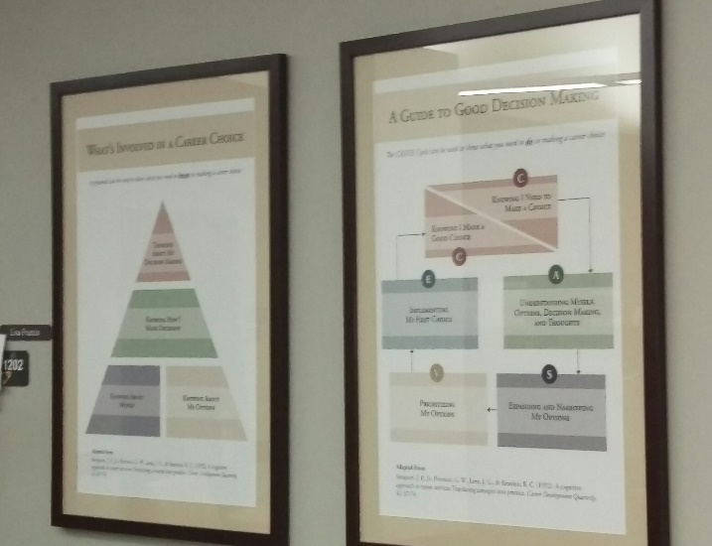
Key Elements Associated with Successful Collaboration
Faculty with commitment to applying theory/ research in practice
Having faculty in counseling program who are focused on career and vocational psychology related areas
Career center leadership/staff--interest in theory-based interventions and research to inform practice
Student services unit that welcomes faculty involvement/engagement
Access to graduate students to support research
Notes:
Janet

Slide 9
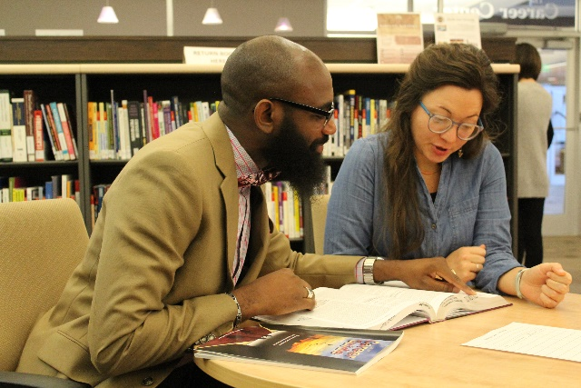
Strategies to Sustain Collaborations Over Time
Research team that includes faculty and career center staff
Faculty understanding the importance of translating theory & research into practice—client versions of materials
Faculty involvement in training/supervising career center staff
Space in career center settings that allows for collaboration & testing out of ideas (career center as “laboratory”
Career center “in kind” support—space, access to computers, grad students, copier, support for conference travel, etc.
Connects career center mission to teaching and research, along with service
Notes:
Janet

Slide 10
Organizational challenges & issues
Lack of faculty with interest in career and vocational psychology related areas
Lack of support from faculty member’s “academic home”
Career center leadership that might be focused on other priorities, philosophies related to service delivery and role within the institution
Lack of space for collaborative efforts within career center setting
Limited access to graduate students to support research
Lack of career center staff “buy-in” regarding service delivery, research activities
Higher level leadership within student affairs that does not see the value of these types of collaborative efforts
Notes:
Janet

Slide 11
Measurable outcomes and products related to collaborative efforts
Training materials for career center staff
Client-focused resources for use in service delivery
Cooperative partnerships related to conducting research/generating publications (monographs, SDS/CIP handbook, career planning class text, journal articles)
Web site that allows TRP resources to be “given away”
National and international recognition for career center’s theory-based service delivery model
Notes:
Casey

Slide 12
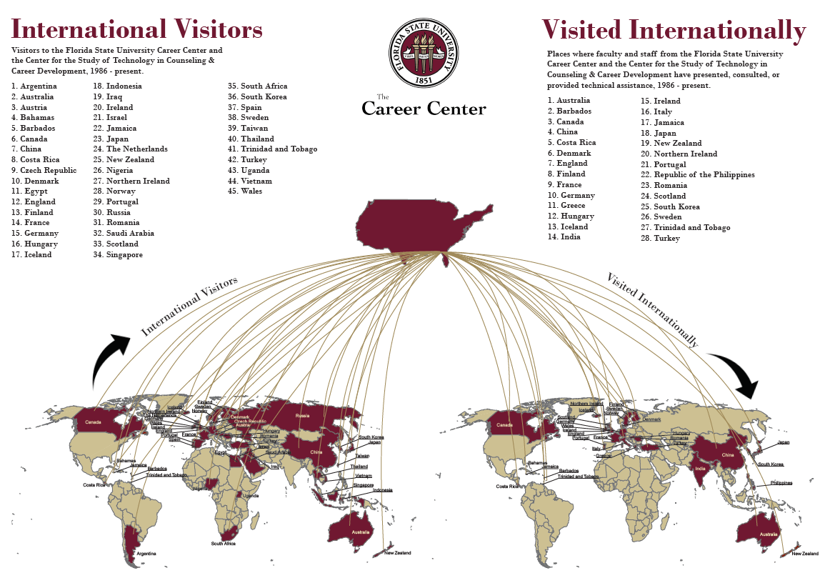
Notes:
Casey
If someone comes to visit – make note of it and build a map

Slide 13
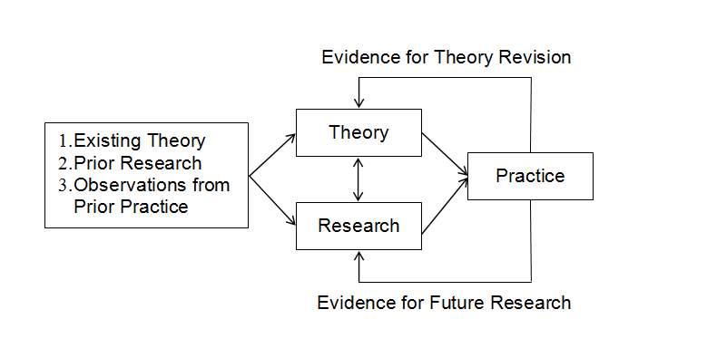
Activity: Brainstorm a potential goal
How is your practice aligned with theory?
How might research contribute to resolving an issue in practice?
Think about a potential research goal?
What activities or resources are needed to implement your goal(s)?
What is a tentative timeline to gather resources and complete your goal(s)?
What else do you need?
Notes:
David

Slide 14
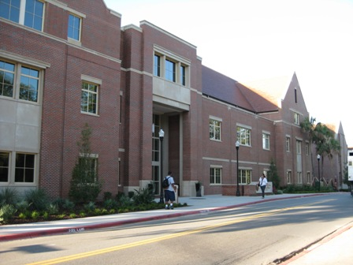
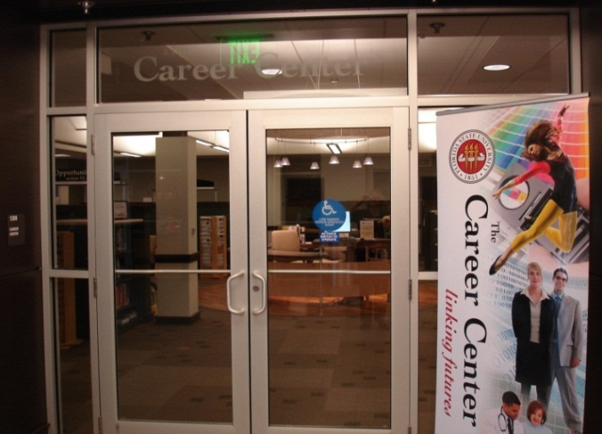
Questions?
NCDA Slides available at
http://www.career.fsu.edu/tech-center/resources/presentations
Florida State University
National Career Development Association, June 2018
Notes:
All

