Slide 1
Hiring, Training, and Managing a
Graduate Student Staff Career Advisor Team
Erin Bennett Ed.S/M.S., NCC - Senior Assistant Director of Career Advising, Counseling & Instruction
Dr. Casey Dozier, PhD, NCC – Program Director of Career Advising Counseling & Instruction
Danny Chiarodit, BA – Career Advisor, Counseling & School Psychology Graduate Student

Slide 2
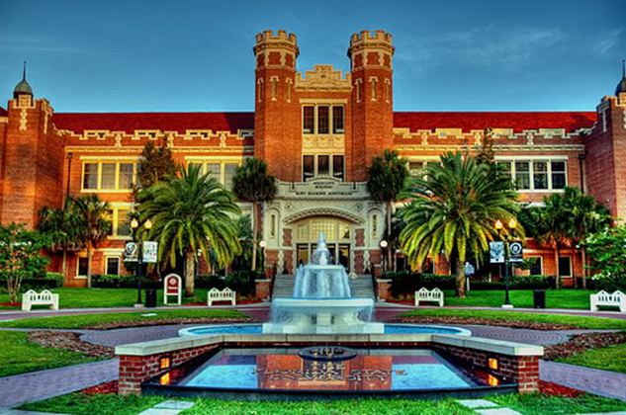
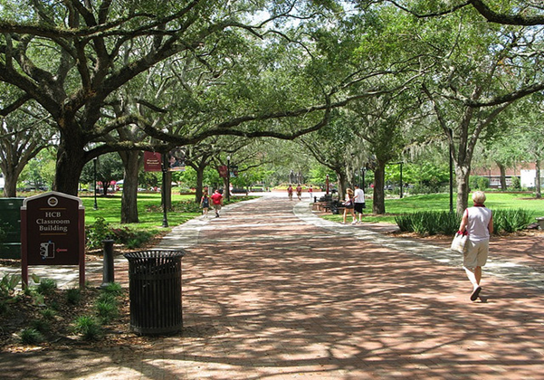
Florida State University
Research university with over 45,000 fulltime students, over 11,000 graduate students across 18 colleges/departments
Programs include 103 undergraduate degrees,107 master programs, 6 specialist degrees, 63 doctorate degrees and 4 professional degree
Nationally recognized for research, academics, athletics (Go Noles!)

Slide 3
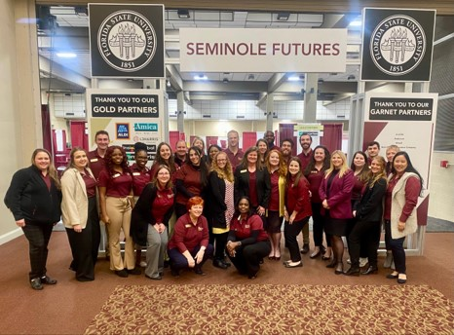
Florida State Career Center
41 full-time staff
14 graduate students
33 student assistants
Operate primarily on a drop-in basis
Over 15,000 visits annually

Slide 4
Florida State Career Center
Comprehensive/Centralized
Explore majors and careers - career decision-making, identify values, interests, and skills
Support career research
Enhance employability skills such as resumes, cover letters, and interviewing, etc.
Provide experiential opportunities such as shadowing, badging, etc.
Connect students to employers via NoleNetwork, Career Fairs, etc.

Slide 5
The Career Advisor Team
Administration
Career Advising, Counseling & Instruction
Career Advisors
Experiential Learning
Employer Relations
Tech Center (Research arm)

Slide 6
Career Center Mission
Vision
Preeminent career center model
Designing and delivering comprehensive, innovative, and inclusive career and employment services
Mission
Our values of Inclusion, Compassion, and Respect play a critical role in our mission to:
Provide comprehensive career services
Train career service practitioners
Conduct life/career development research
Disseminate information about life/career services and issues to the University community, the nation, and the world caring for and improving human life
https://career.fsu.edu/about-us/vision-and-mission

Slide 8
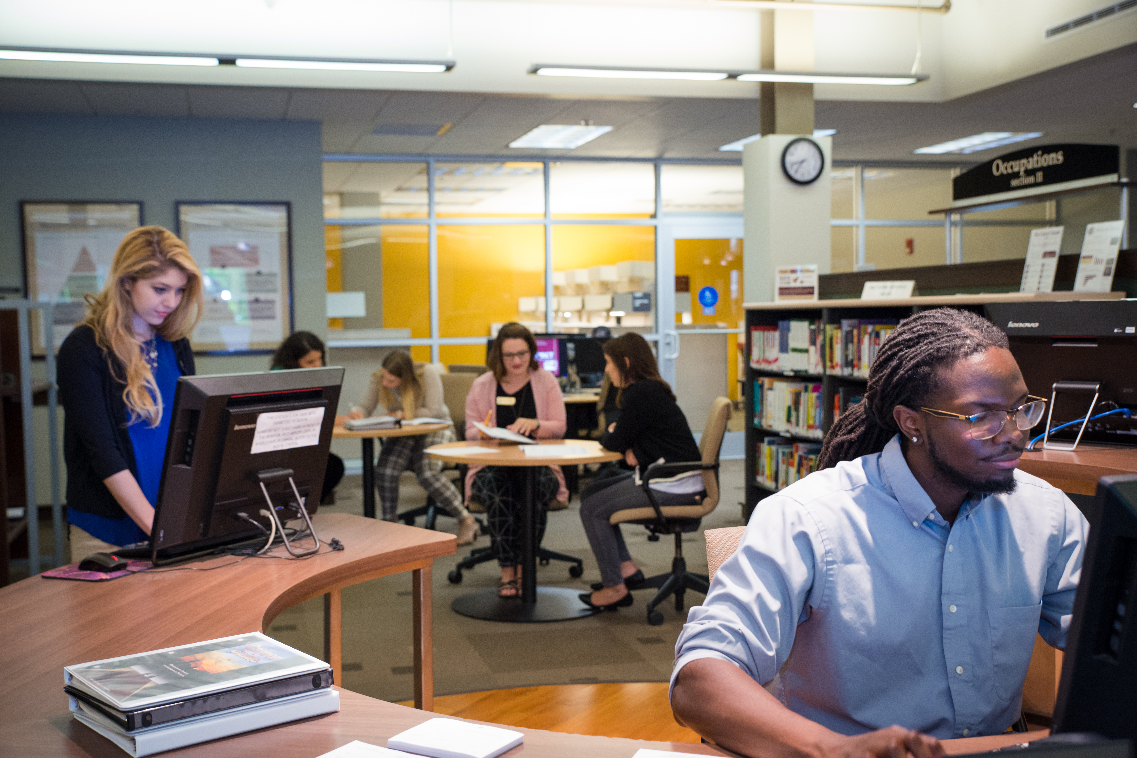
Drop-In Career Advising & Scheduled Appointments
Virtual and In-Person advising available!
Visit career.fsu.edu/hours for more info.
Career Advising
9:00 a.m. – 4:00 p.m.
Monday through Friday
Check website for virtual hours

Slide 9
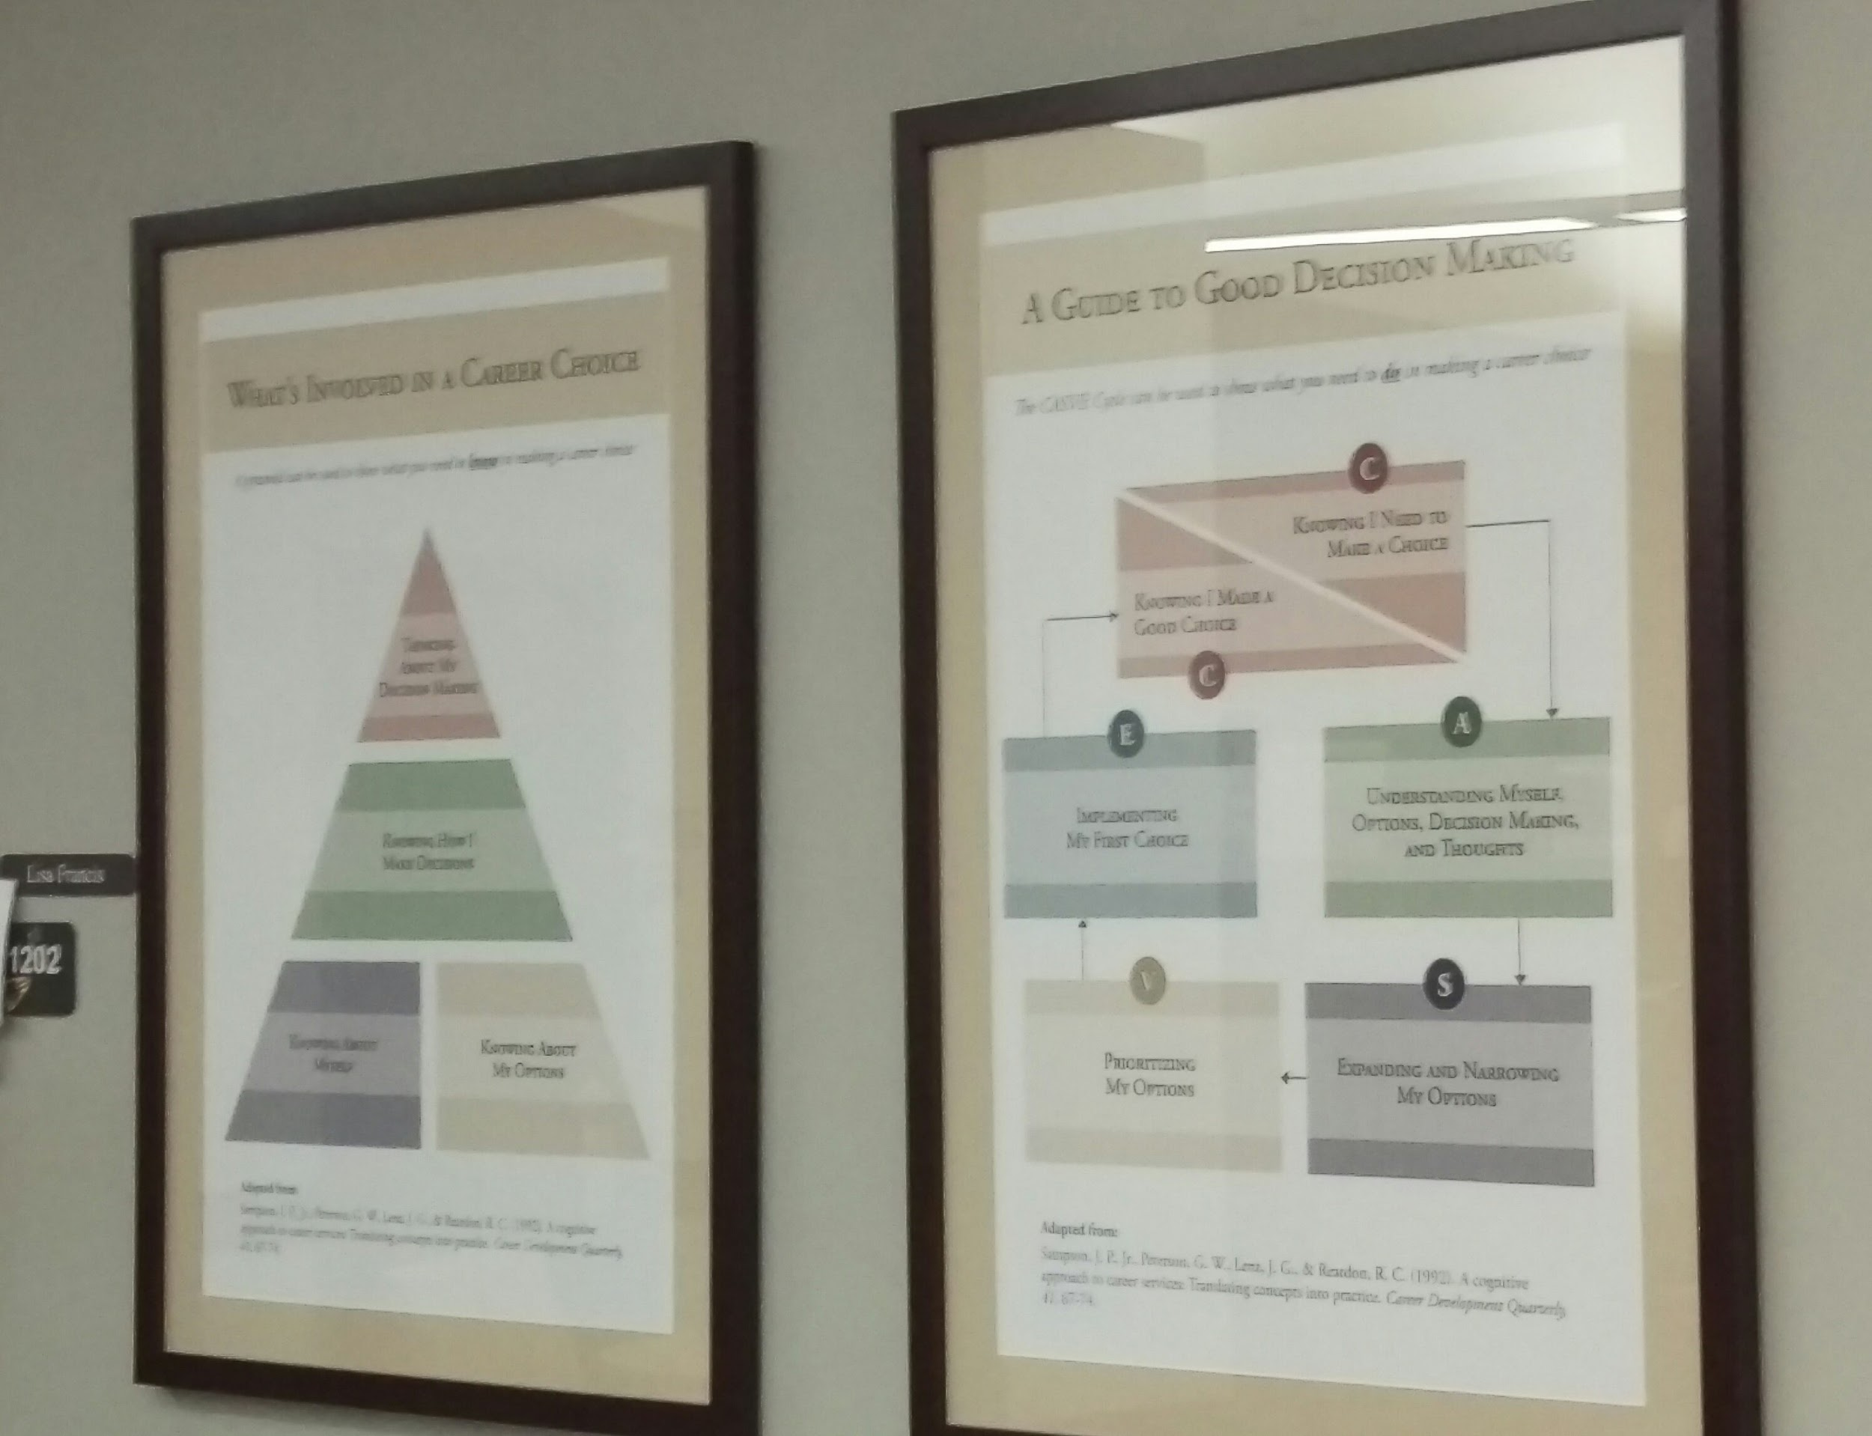
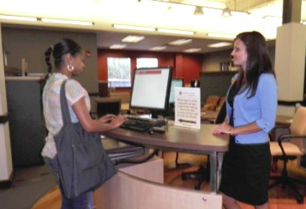
Differentiated Service Delivery Model
Individual Enters
Brief Screening
Self or Staff
Referral
Comprehensive Screening
Self-Help
Services
Brief
Staff-Assisted
Services
Individual
Case-Managed
Services
Complete differentiated model of delivering career resources and services

Slide 10
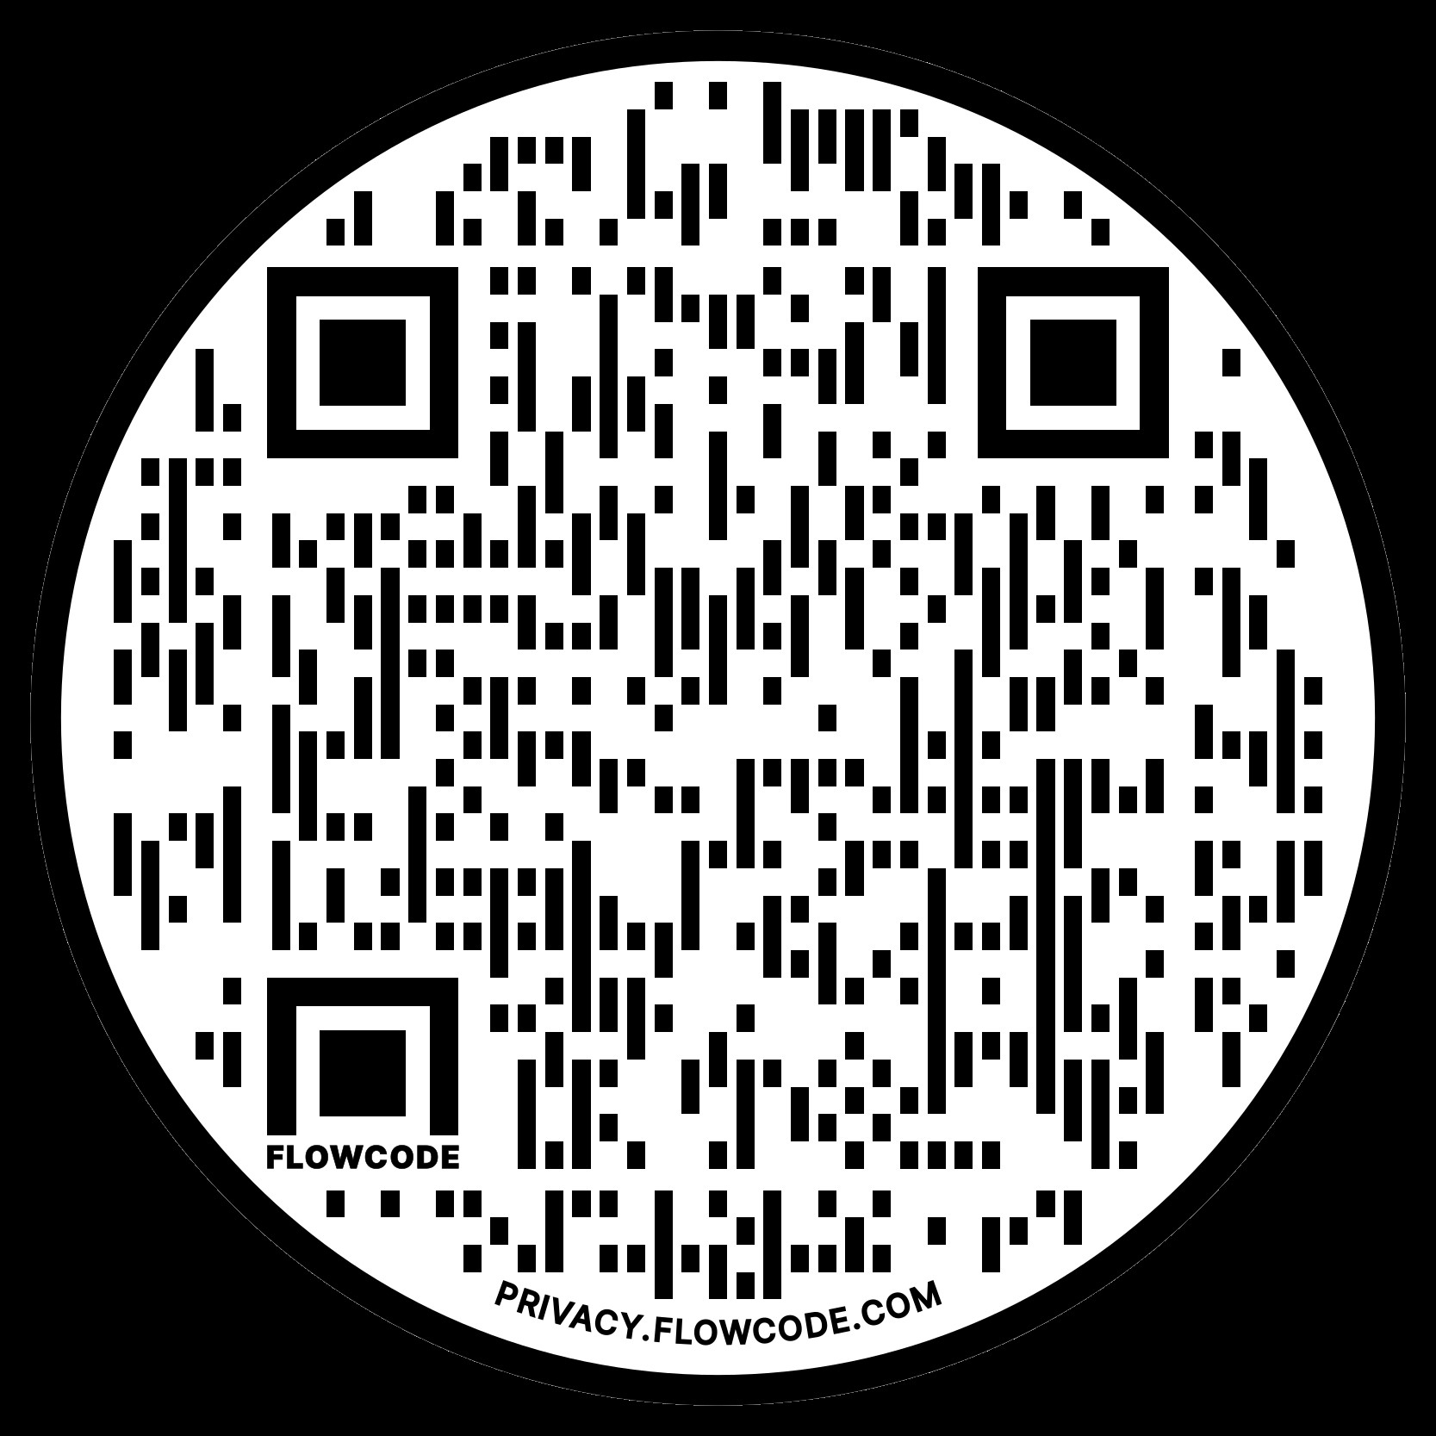
CIP Theory

Slide 11
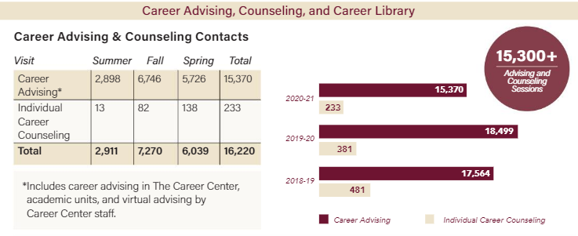
https://career.fsu.edu/about-us/vision-and-mission

Slide 12
Career Advisor Role
Drop-in advising
Workshops, career fairs, Career Docs
Weekly group training meeting and individual supervision meeting
Leadership positions such as Email Manager, Meeting Coordinator, Schedule Coordinator, and Lead Instructor, etc.

Slide 13
Drop-in Advising
Follow brief staff-assisted model
15 - 20 minute sessions
Administer career assessments
Refer clients to career counseling, career liaisons, or other services
Provide resources (i.e. NoleNetwork, Match Major Blueprints, Career Guides)
Main tasks include resume/cover letter reviews, internship/job search, exploring career options

Slide 14
Career Advising Drop-In Topics

Slide 15
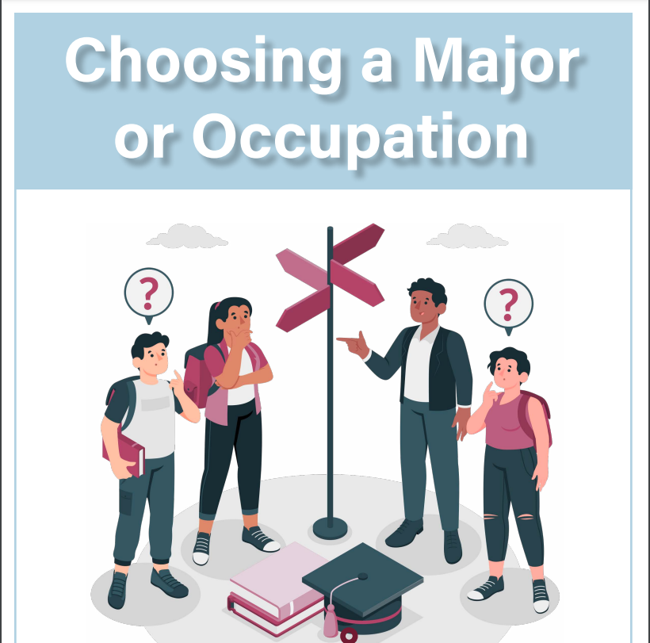
Additional CA Responsibilities
Virtually review resumes, cover letters, and personal statements via Career Docs
Create training materials for future cohorts
Lead weekly group training meetings during the summer
Facilitate workshops for groups on campus, assist at career fairs and other Career Center events

Slide 16
Recruitment & Hiring
Partnership with College of Education (COE)
Influence of the Graduate Student Union
Application & Expectations
Timeline
Program acceptance
International Candidates

Slide 17
Training
Start Date Week Prior to Classes
CA Training: In-Person Learning Sessions
Career Advisor Manual

Slide 18
Teambuilding
Teambuilding
Staff integration
CA Graduation
After hours socials

Slide 19
Training Continued
Training Checklist
Milestones
CA Weekly Meetings
Refreshers offered between semesters

Slide 20
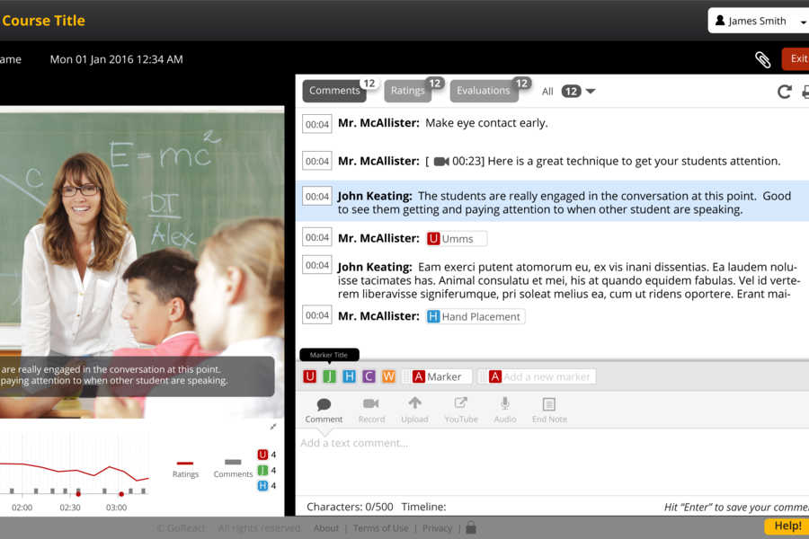
Practicum & Internship
Training
Supervision
Dual relationships
GoReact

Slide 21
Supervision
Individual & triadic supervision
Supervision milestones
Evaluations – programmatic vs. HR
Professional development funds

Slide 22
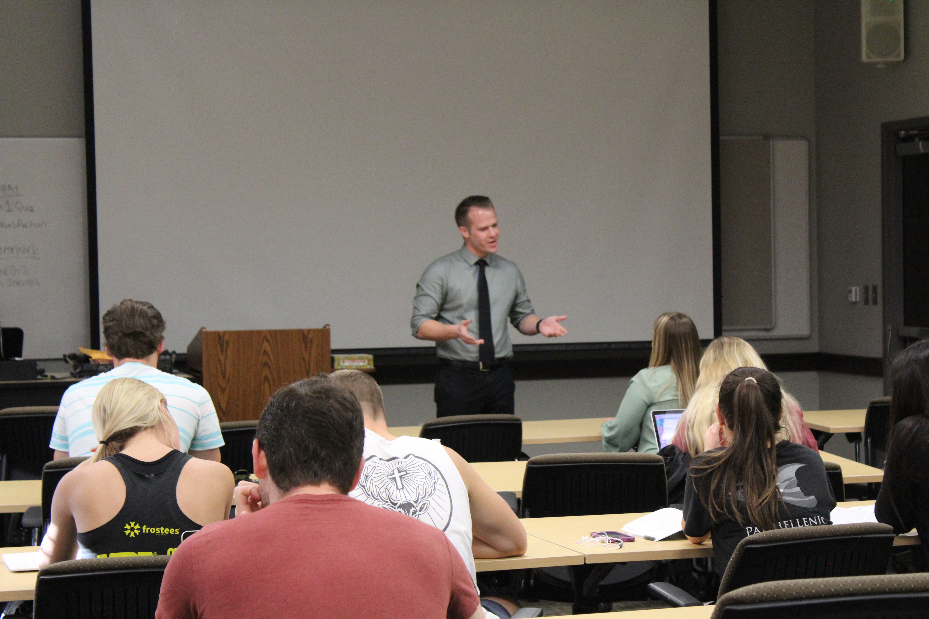
Teaching Opportunity
Theory-based credit baring career development class (up to 3 hours)
Cognitive Information Processing (CIP) integrated into text, class lectures, small group activities
Career Thoughts Inventory (CTI) used as pre-posttest
Research shows course produces significant decrease in negative career thoughts

Slide 23
Final Thoughts
Value in having graduate students as the "front line" for providing career services
Importance of fostering a team atmosphere among CAs and full-time staff
Holding CAs to the expectation of being professionals
Potential audience takeaways
Learn more about CIP Theory
Brainstorm ways to make your career services more "peer-based"
Connect with colleagues across campus to identify student career needs

Slide 24
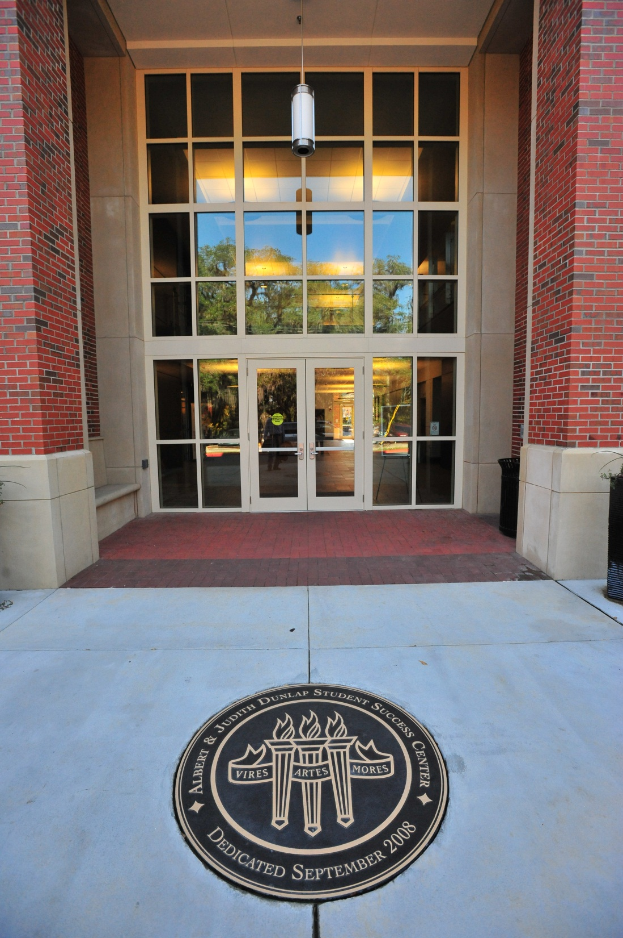
Questions & Discussion
The Career Center
Florida State University
Dunlap Success Center
(850) 644-6431
https://career.fsu.edu/tech-center/resources
Erin Bennett – erin.bennett@fsu.edu
Dr. Casey Dozier – casey.dozier@fsu.edu
Danny Chiarodit – dchiarodit@fsu.edu

