Slide 1

Chapter 2
Knowing About Myself

Slide 2

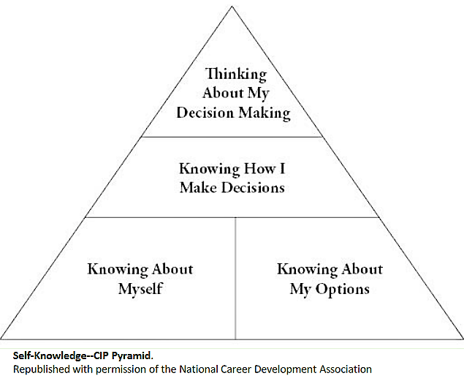
What’s Involved in Career Choice?

Slide 3
What do you need to know about yourself to assist you in your career choices?

Slide 4
Self-Knowledge
Values
Interests
Skills

Slide 5
Self-Knowledge
Values

Slide 6
Values
Definition:
Something that is important
or desirable to you

Slide 7
Class Question
How many of you would choose
more money over more time?
Why?

Slide 8
Research Says…
The clearer our values, the easier
the career-planning process!

Slide 9
SIGI3® Career Values*
Contribution to society
High income
Independence
Leadership
Leisure
Prestige
Security
Variety
*Used by permission of Valpar International Corporation

Slide 10
7-Step Values Clarification Process
Choosing a value
Freely and without pressure
From among alternatives
After thinking about the results

Slide 11
7-Step Values Clarification Process
(continued)
Prizing your values
Being pleased with your choices
Being willing to state publicly
Acting on your values
Doing something behavioral
Acting consistently & repetitively

Slide 12
Self-Knowledge
Interests

Slide 13
Interests
Definition:
Those things a person does
for fun or enjoys

Slide 14
Interest Measurement
Expressed Interests
Assessed Interests
What do you think is the difference?

Slide 15
4 Ideas in Holland’s Theory
Most persons can be categorized as
one of six types.
There are six kinds of environments
People search for environments where
they can express their skills, abilities,
values, attitudes, etc...
Behavior is determined by interaction
between personality & environment.

Slide 16
Holland Types
Realistic
Investigative
Artistic
Social
Enterprising
Conventional

Slide 17
Identifying Interests
Self-Directed Search (SDS)
O*NET Interest Profiler

Slide 18
Self-Knowledge
Skills

Slide 19
Skills
What can you do?
Things we can do well
Behaviors we have learned/acquired/developed
Special talents and abilities

Slide 20
Collegiate Employment Research Institute
New hires need skills in 3 areas:
Problem solving
Interpersonal communication
Teamwork

Slide 21
Identifying Skills
SAT, MAT, ACT, LSAT, & MCAT
What Color is Your Parachute?
(Bolles, 2018)
FSU Online Career Portfolio
www.portfolio.fsu.edu

Slide 22
FSU Portfolio Skills
Career/life management
Communication
Creativity
Critical thinking
Global/intercultural fluency
Leadership
Professionalism/work ethic
Research/project development
Social responsibility
Teamwork
Technical/scientific

Slide 23
Transferable Skills
Interpersonal skills are important to
prospective employers including:
Communication
Adaptability
Problem solving
Responsibility
Positive demeanor
Teamwork

Slide 24
Improving Self-Knowledge
Thinking better about myself:
Don’t over generalize from past experiences
Don’t rely too much on other’s opinions
Avoid making decisions while in a crisis
Make full and thoughtful use of available tools
Use clear, complete self-knowledge

Slide 25
Improving Self-Knowledge
Seek out/acquire varied life experiences
Process/talk about these experiences
Connect life experiences and events to one another
View this as a lifelong process

