Slide 1
Career & Mental Health
Dr. Deb Osborn, Jackie Belle, and Shae McCain
ACA 2016, Montreal

Slide 2
Interconnectedness of career & mental health
Theo is highly introverted, with few verbal interactions, indicates having no friends and wanting a job that doesn’t involve people. No career option or career intervention is interesting to him, and yet he wants to find a job. Is this a career problem or a mental health problem?
Kelly’s fiancé is wanting her to relocate to another state to be with him. She does not really want to move as she sees that she has greater work opportunities here, but as they are newly engaged feels like she doesn’t really have a choice. When she tries to explain her reasons for wanting to stay, it explodes into a huge argument. Is this a career problem or a relationship problem?
Hannah has been unemployed for 2 years, gets by on staying with friends and relatives for short stints, food stamps, and food pantries. Consistent housing and transportation, lack of professional attire, spotty job history, limited education, and poor interpersonal skills are challenges she faces. She wants a job but feels like she has no skills to offer, and multiple rejections reinforce this belief. Is this a career problem, mental health problem, educational problem, poverty problem, or societal problem?
Notes:
2

Slide 3
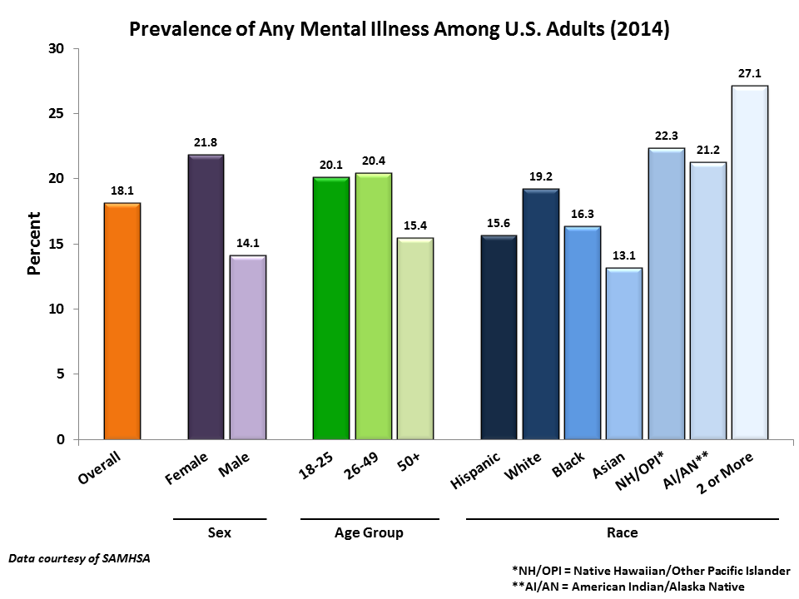
Notes:
Anxiety – 12 month prevalence, 18%, lifetime, 29%
Depression – 12 month prevalence, 6.6%
Mood disorders -12 month prevalence, 9.5%, lifetime, 21%
Any personality disorder, 12 month prevalence, 9.1% (lifetime not reported)

Slide 4
Prevalence
About 1/4 of adults have diagnosable mental disorder
(http://www.nimh.nih.gov/health/statistics/prevalence/any-mental-illness-ami-among-us-adults.shtml)
1/17 adults have a serious mental illness (NAMI, 2013)
18.6% had diagnosable form of mental disorder (SAMHSA, 2012)
Unemployment (3.1 million, SAMHSA, 2014)
Issues of prejudice & discrimination in life and work (hiring, promotion, etc.)
(Sangganjanavanich & Headley, 2014-2015)

Slide 5
College Campuses
2012 National Study of 28,237 college students
30% of students so depressed it was difficult to function
85% overwhelmed
80% exhausted (not from physical activity)
60% very sad
57% lonely
50% overwhelming anxiety
45% hopeless
American College Health Association’s National College Health Assessment (ACHA-NCHA)
Notes:
Over past 12 months

Slide 6
Why do we care?
“Mental disorders are usually associated with significant distress or disability in social, occupational or other important activities”
DSM-5, p. 20
Depression and Anxiety often follow unemployment (Gati, Asulin-Peretz, & Fisher, 2012; Nauta, 2012; Saka & Gati, 2007)
Impacts their ability to use services effectively
(Lenz, Peterson, Reardon, & Saunders, 2010)
They come to us for help

Slide 7
CD & MH
Increased focus on this connection (Blustein; Walker & Peterson, 2012; Zunker, 2008)
Often reciprocal in nature (Hinkleman & Luzzo, 2007)
Correlates:
Career adaptability and positive personality traits (NE); Rossier et al., 2012 and others), positive life orientation (Rottinghaus et al.,2012), internal locus of control, less procrastination, less dependence on/desire to please others (Gadassi et al., 2012, 2013)
Undifferentiated profiles (may be depressed, apathetic, etc.)
Career indecision and dysfunctional career thinking (Dieringer, 2012)
Notes:
Rossier-extroversion, conscientiousness, openness to new experience, aggreeableness

Slide 8
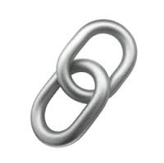
CD & Mental Health
Long term unemployment & depression (Rottinghaus et al. 2009; Saunders 2000; Walker III & Peterson, 2012) & anxiety (Gati et al., 2012; Nauta, 2012; Saka & Gati, 2007).
Career decidedness and subjective well-being (Uthayakumar, Schimmack, Ulrich, Hartung, & Rogers, 2010)
Career decision making difficulties and anxiety (Lancaster et al., 1999)
Career adaptability and neuroticism (Rossier et al., Rottinghaus, et. al, and others)

Slide 9
Connections: CD & Anxiety
Long term unemployment
(Gati, Asulin-Peretz, & Fisher, 2012; Nauta, 2012; Saka & Gati, 2007)
Dysfunctional career thoughts
Self-reported difficulty
(Saka, Gati, & Kelly, 2008)
Anxiety about communicating and DCTs
(Meyer-Griffith, Reardon, & Hartley, 2009)
Career indecision (trait more than state)
Brown & Rector, 2008; Mojgan, Kadir, & Soheil, 2011; Santos, 2001

Slide 10
CD and Depression
Those who made a career decision report less depression
(Rottinghaus, Jenkins, & Jantzer, 2009).
Dysfunctional career thoughts and occupational indecision related to depression
(Walker & Peterson, 2012).
Career indecision
(Saunders et al. 2000)
Career indecision, lower vocational identity, self-defeating characteristics (Sweeney & Schill, 1998)
Dysfunctional career thoughts
(Saunders et al., 2000)
Notes:
Measures picking-up on CD related depression: NEO, BDI, MMPI, STAI

Slide 11
Mental health constructs directly correlate with dysfunctional career thoughts
☑indecision
☑neuroticism
☑anxiety
☑angry hostility
☑depression
☑hopelessness
☑impulsivity
☑vulnerability

Slide 12
Hot off the presses
Multiple case study qualitative study
Career Thoughts Inventory & MMPI
5 cases with CTI’s greater than 65 from diverse backgrounds
4 MMPI experts independently reviewing these cases
Preliminary Findings?- depression, anxiety, negative treatment factors, somatic complaints, hallucinations, poor coping, work problems found by 4 experts across most cases.

Slide 13
Two Tools To Explore Both Career and Mental Health
Based on Cognitive Information Processing Theory
(CIP; Sampson, Reardon, Peterson, & Lenz, 2004)
Career Thoughts Inventory (CTI)
Sampson, Peterson, Lenz, Reardon, & Saunders (1996)
Decision Space Worksheet (DSW)
Peterson, Leasure, Carr, & Lenz (2010)

Slide 14
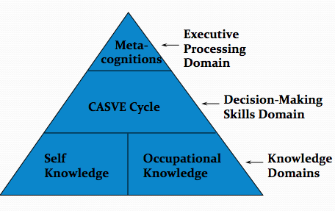
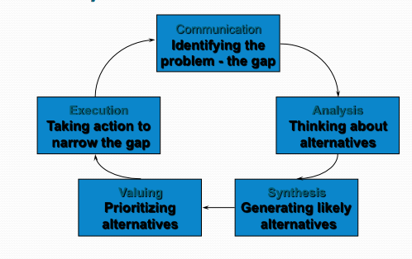
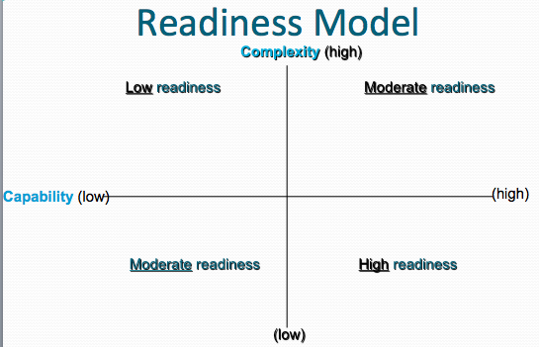
CIP Theory
Notes:
The capability of an individual to make appropriate career choices taking into account the complexity of family, social, economic, and organizational factors that influence career development
Readiness also includes possessing adequate language skills and literacy skills for communication and learning

Slide 15
What is the CTI?
Self-administered
Objectively scored
48-Item measure of dysfunctional thoughts in career choice

Slide 16
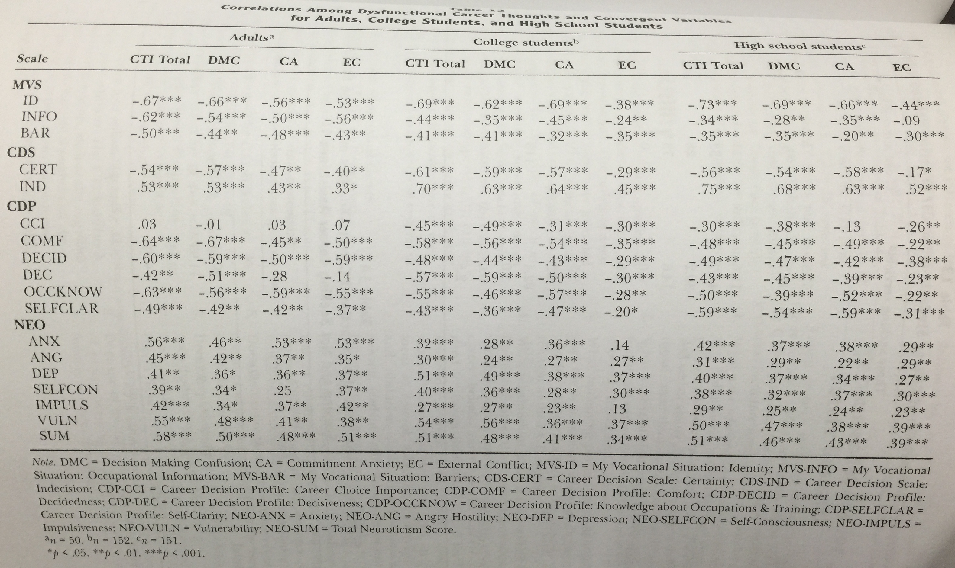
CTI Correlates
Notes:
When originated, correlated CTI with decision making inventories My Vocational Situation, Career Decision Scale, and Career Decision Profile, as well as the NEOPIR (personality). The stars show the correlations comparing those to CTI Total, DMC, CA, and EC.

Slide 17
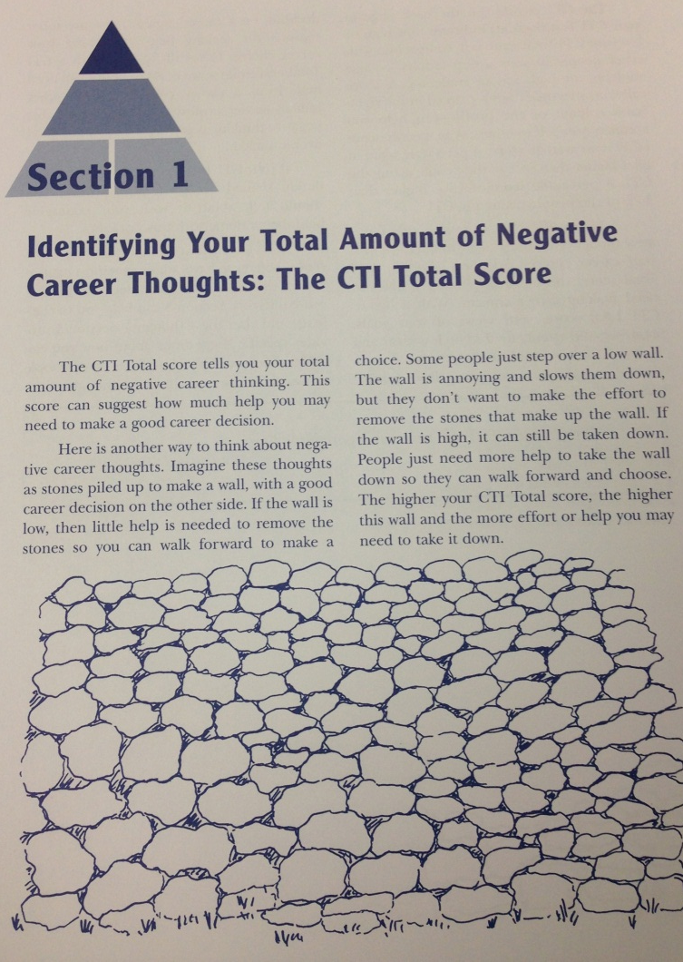
CTI Workbook

Slide 18
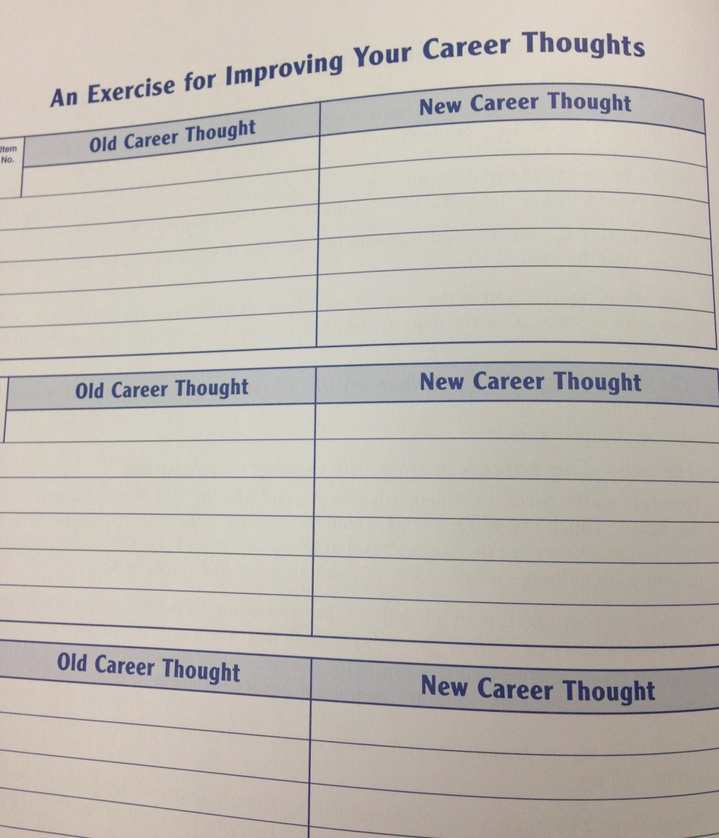
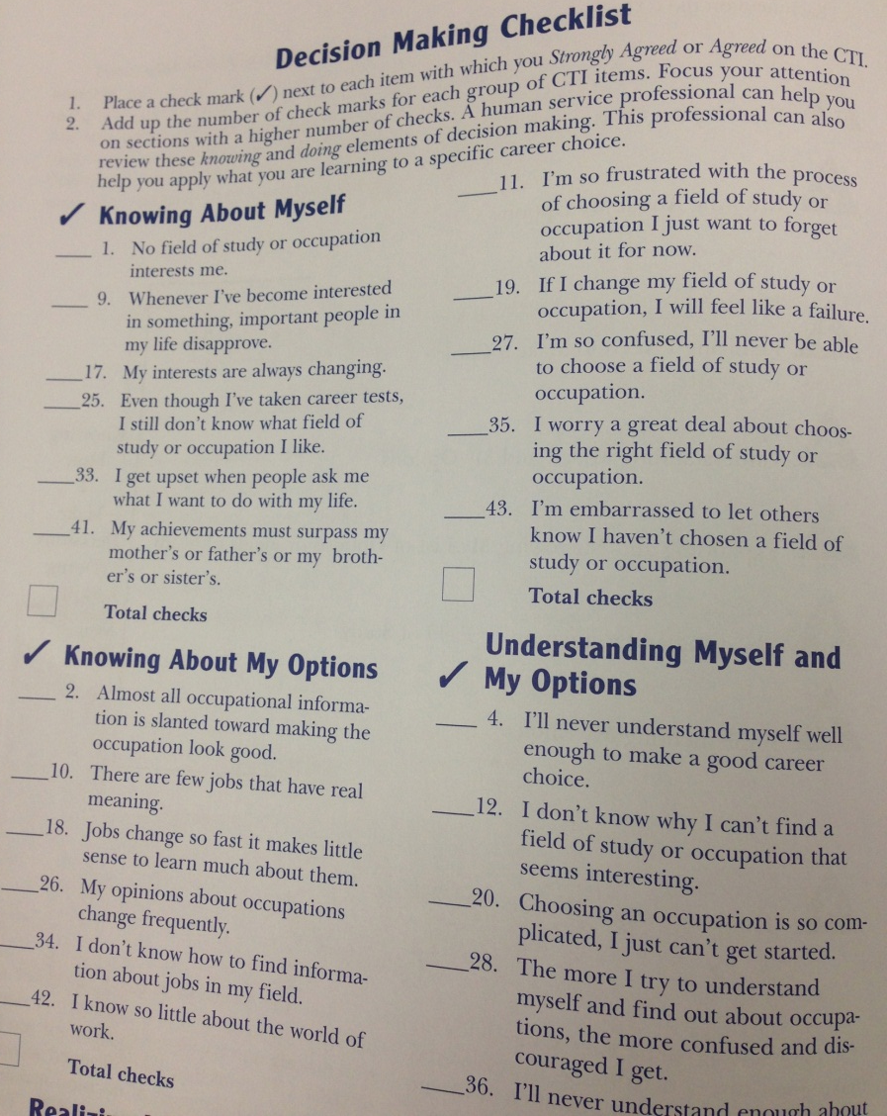
CTI Workbook

Slide 19
Decision Space Worksheet (DSW)
Cognitive mapping task
Helps clients reveal thoughts, feelings, persons, circumstances associated with career decision
Helps clients prioritize importance of contextual influences
Can be used with middle school through college level students and adults
Peterson, G. W., Leasure, K. K., Carr, D. L. & Lenz, J. G. (2010). The Decision Space Worksheet: An assessment of context in career decision making. Career Planning and Adult Development Journal, 25, 87-100.

Slide 20
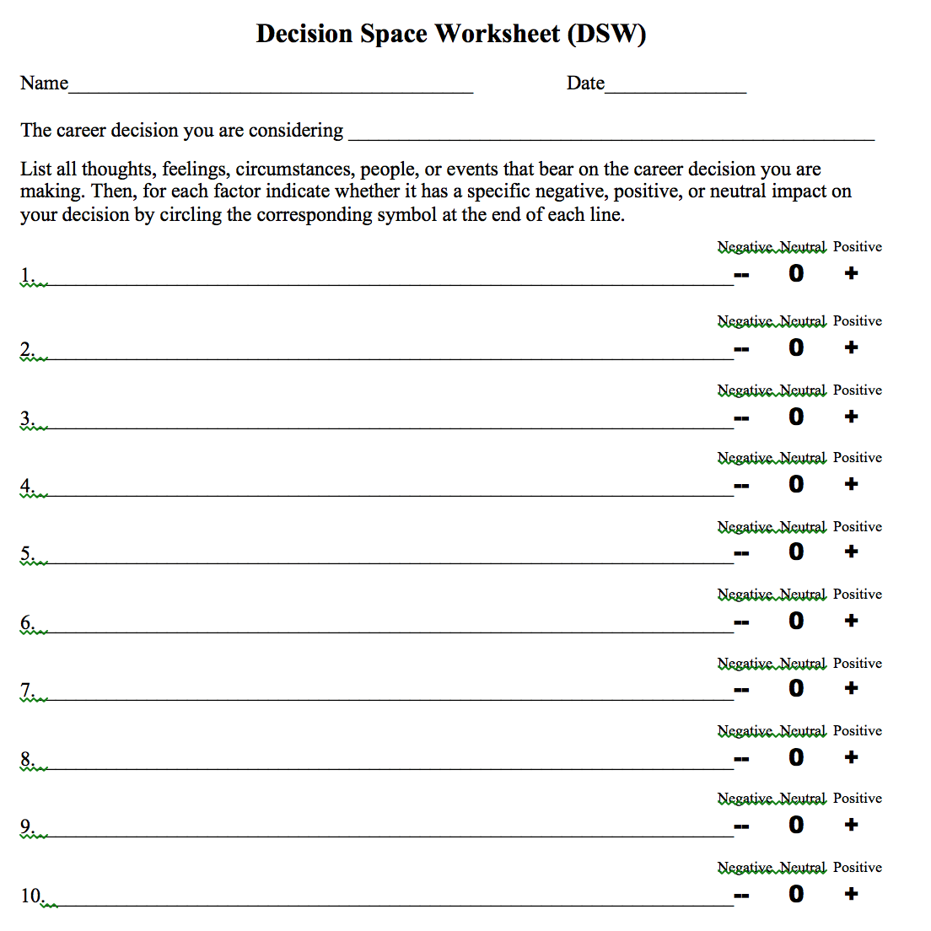
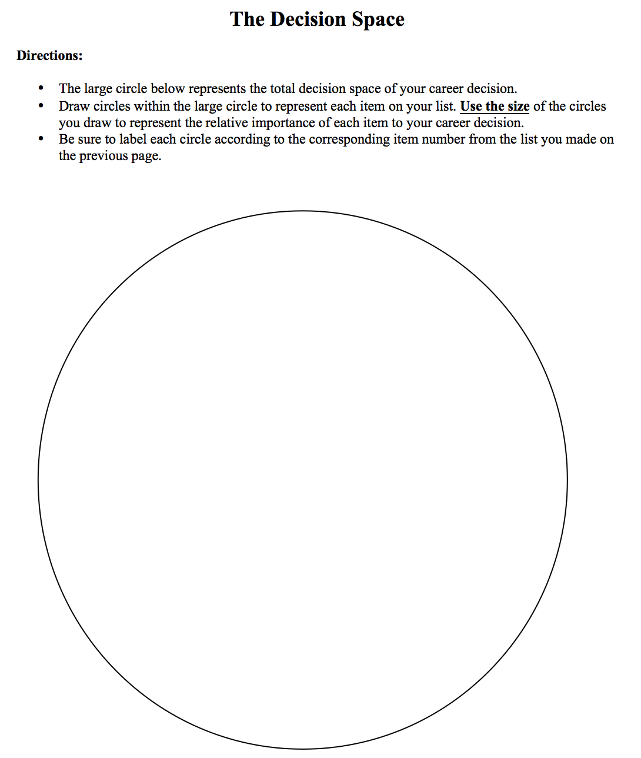
Decision Space Worksheet http://tinyurl.com/careerhandouts
Notes:
Free, along with other resources, at this url.

Slide 21
Types of Issues Revealed
Cognitive distortion
Disabling emotions
Financial
Family
Education
Interests
Self doubt
Employment
Quality of life

Slide 22
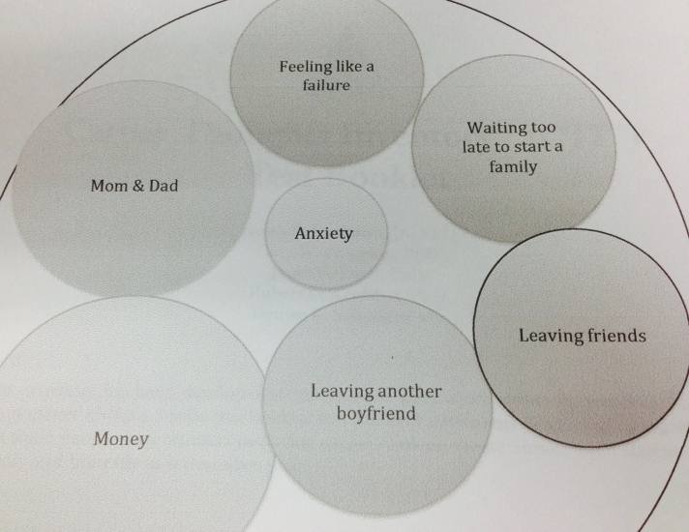
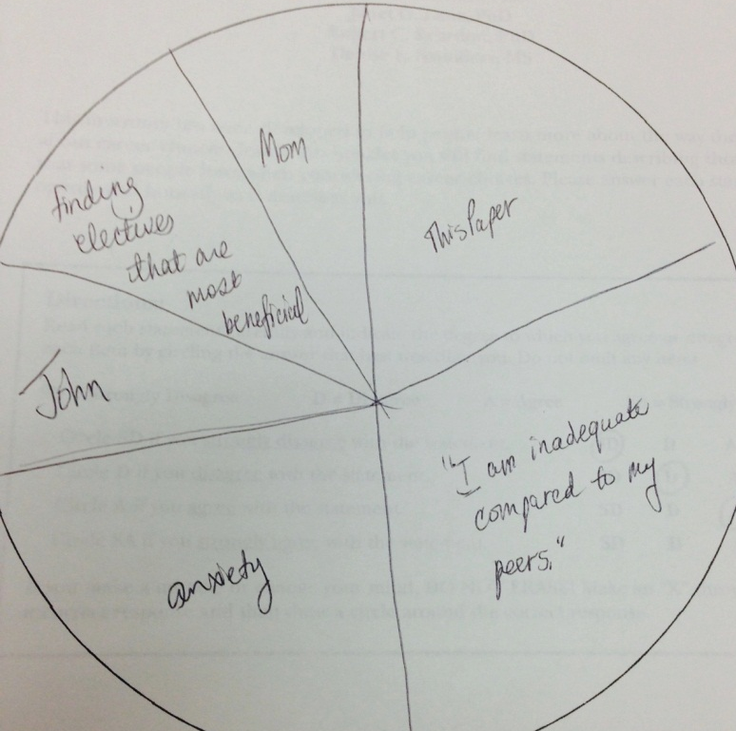
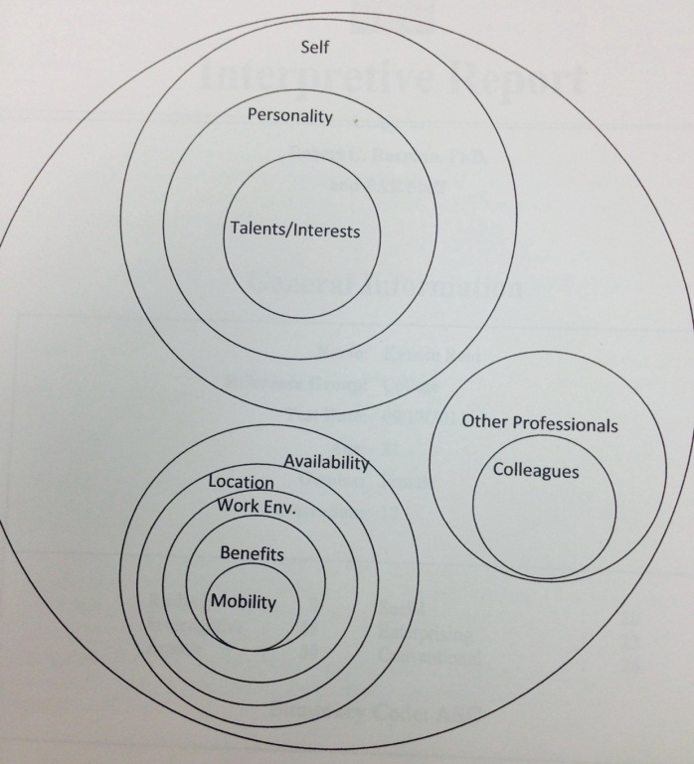
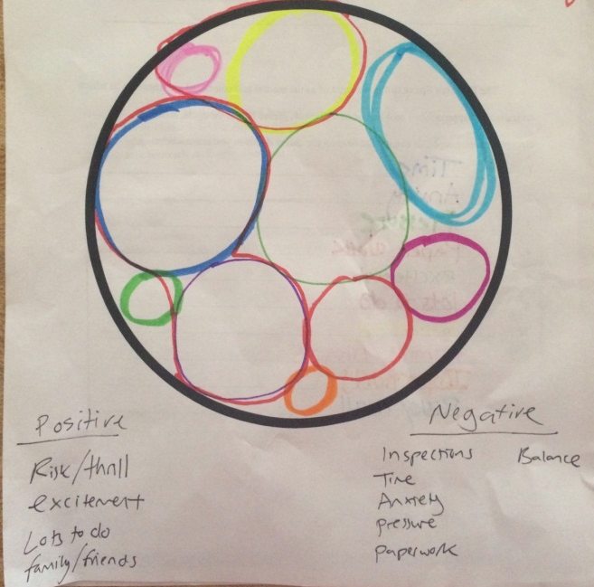
Sample DSWs

Slide 23
Other Tools That Address Both?
Career Decision-Making Difficulties Questionnaire (CDDQ) and Emotional and Personality-related Career Decision Difficulties
(http://kivunim.huji.ac.il/cddq/)
Career Flow Index (Niles, Yoon, & Amundson, 2010)-Measures 6 hope-centered career development competencies: hope, self-reflection, self-clarity, visioning, goal setting and planning, implementing and adapting
Early Recollections
(McKelvie.; Watkins, 1984)
Self-Directed Search profile elevation
those with low scores less willing to consider options and more likely to be frustrated (Bullock & (Reardon, 2008)
low –more negative responses, low self-estimates
(Holland & Messer 2013)
Others?
Notes:
Ask audience for Other examples? (card sorts-can get at MH issues if they talk aloud, especially values card sort)
Ers: Adlerian approach

Slide 24
Strategies
Basic screening questions (Saunders et al., 2000)
Be sensitive to symptoms
Demonstrating the connection between MH & career
“When you tell yourself you are not good at anything, how might that statement impact the way you look at your strengths and skills?”
Cognitive Restructuring
Goal setting
Focus on well-being across life roles (comprehensive approach-Lenz et al., 2010)
Use assessments cautiously
Notes:
Assessments – Determine if the client can quiet the thoughts specific to the mental illness enough to make an objective judgment on the items being presented (Is that the depression talking or do I really not like an activity?) Dependent PD may over-rely on test results;

Slide 25
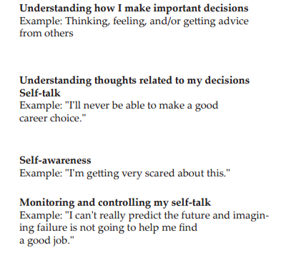
http://tinyurl.com/careerhandouts
Guide to Good Decision Making:
Notes:
http://www.career.fsu.edu/Students/Plan-Your-Career/Guide-to-Good-Decision-Making

Slide 26
Sigi3: Deciding Matrix http://www.sigi3.org/

Slide 27
Cognitive Restructuring
Cognitive Restructuring
CIP Workbook
Triggering Event | Negative Thought | Feeling | Theme of Statement | Reframe
I chose accounting as a career, and now that I’m on internship, I hate it. | I can’t make good decisions | Deflated, hopeless | Incapable, stupid, doomed | If I take my time and go step by step, I’m sure I can make a good decision.
Notes:
Use cognitive restructuring activities that help clients identify, challenge, and alter career thoughts
CORE BELIEFS (Why you need to do several of these –see the themes)

Slide 28
Scaling Questions (Corcoran, 2004)
Questions designed to focus on the immediate feeling (e.g., anxiety, depression, hopelessness).
Motivational interviewing/solution-focused techniques
Focus is on goal setting and empowerment

Slide 29
Sample statements
“On a scale of 0 to 10, with 10 meaning there is no anxiety at all and 10 meaning severe anxiety, what number would you give to your anxiety about making a career choice?”
“You stated you are currently at a _____. What events have lead up to you feeling this way?”
“What level would you like to be at?”
“What would that level feel like? What would it look like if you dropped one level to ____?What would be different? What would you be doing differently?”
“When thinking about your next step in your career decision, what goal would you like to set for yourself?”
Notes:
Could also ask: 0-10 – What # would it take to consider the problem to be sufficiently solved?
0-10 How confident are you that it will be solved?
What’s the most important thing you have to do to keep things at a ____ to _____ level? (h to 10)

Slide 30
Miracle Question
Miracle Question
If you woke up tomorrow and the problem was gone, how would things be different, how they would think and feel about themselves, and what they and others would observe.
What is the 1st thing you would notice that is different?
What other things would you notice?
Would anyone beside you notice that a miracle had occurred? What would they notice?

Slide 31
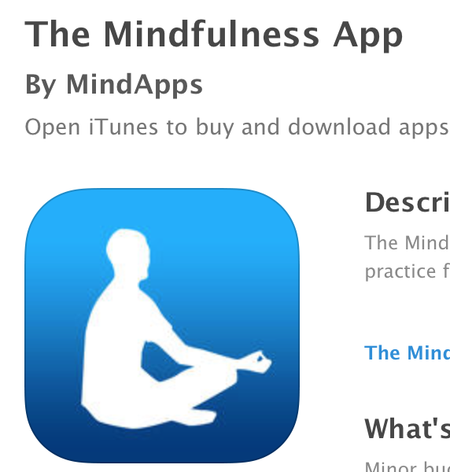
Mindfulness Approaches
Sensory awareness of body/breathing in the moment (let it be)
Mindfulness of thoughts
Leaves on a stream, clouds in a sky, pages written on water (livingwell.org.au)
Progressive muscle relaxation
(Bernstein, Borkovec, & Hazlett-Stevens, 2000)
Mindfulness apps
Notes:
Jacobs & Blustein, 2008; Kabat-Zinn, 2003
Awareness and acceptance of the thoughts, emotions, sensations

Slide 32
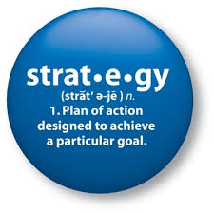
Strategies for Self
Know the policies in your setting for addressing career and mental health concerns
Keep up to date on the research
Correlates, interventions, medication/side effects
Seek additional training (mental disorders, substance abuse, assessments, etc.) and supervision
Know community resources

Slide 33
Ethical Considerations
Training and Credentials
Boundaries
DSM Diagnoses: Know criteria
e.g., trait versus state anxiety
Medications and possible side effects
Know when to refer, know when to keep
Collaborate with other professionals
Supervision

Slide 34
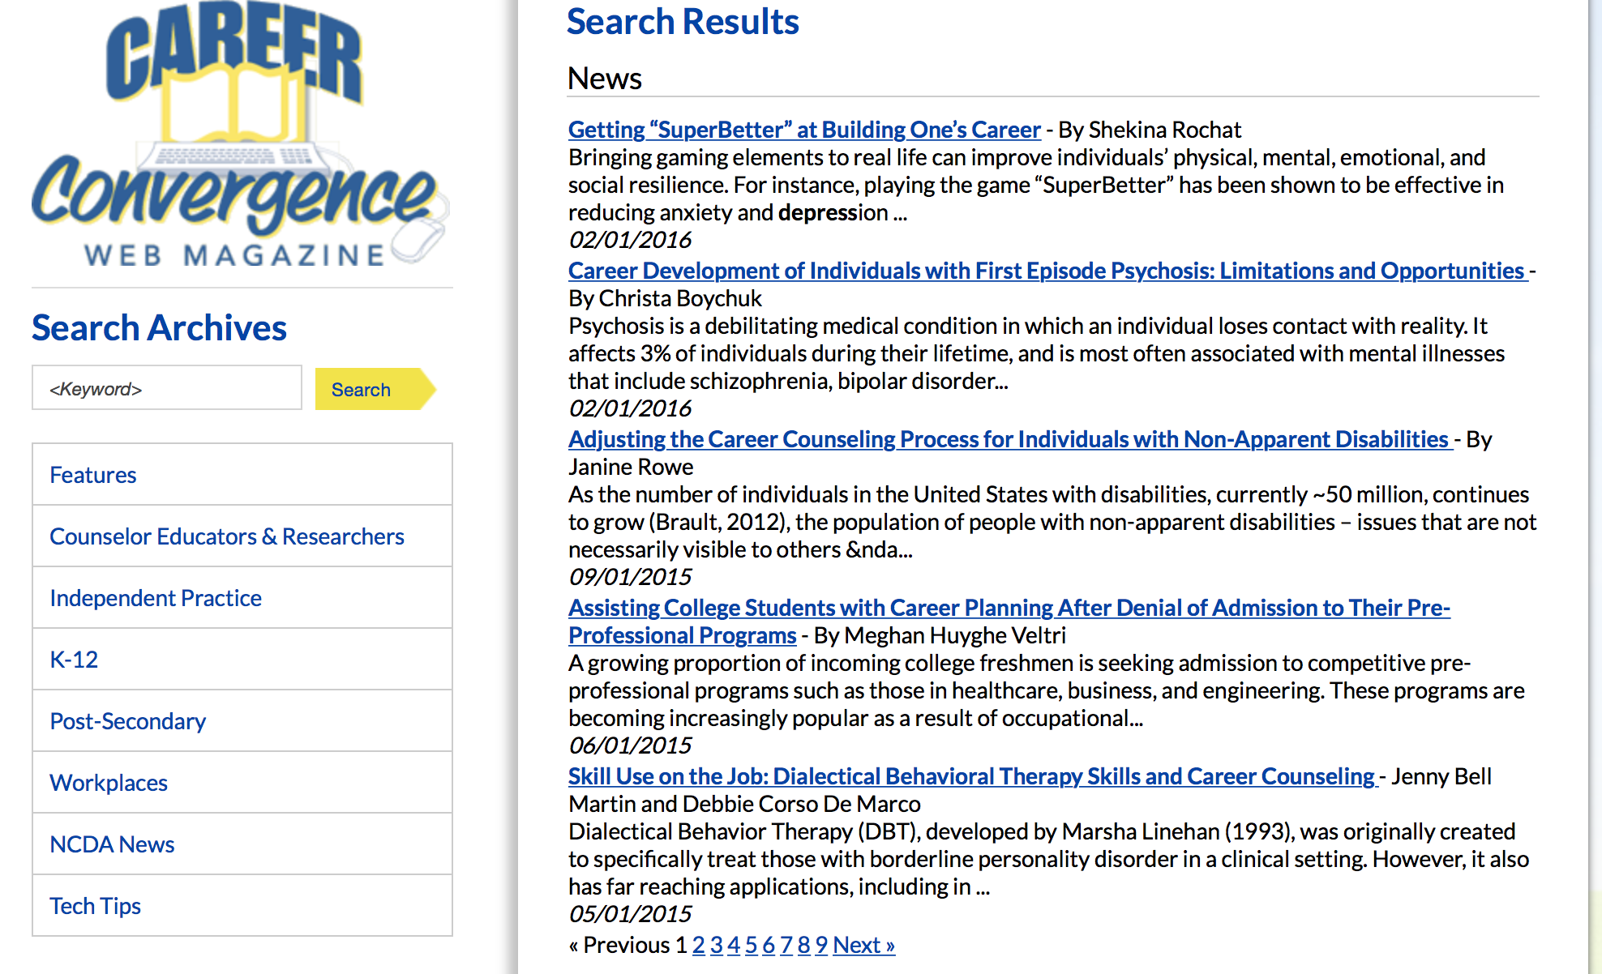
NCDA Resources ncda.org
Counselor’s Guide to Career Assessments
Career Counseling Casebook
Clinical Supervision of Career Development Practitioners
Webinar: Unemployment and Mental Health (Blustein)

Slide 35
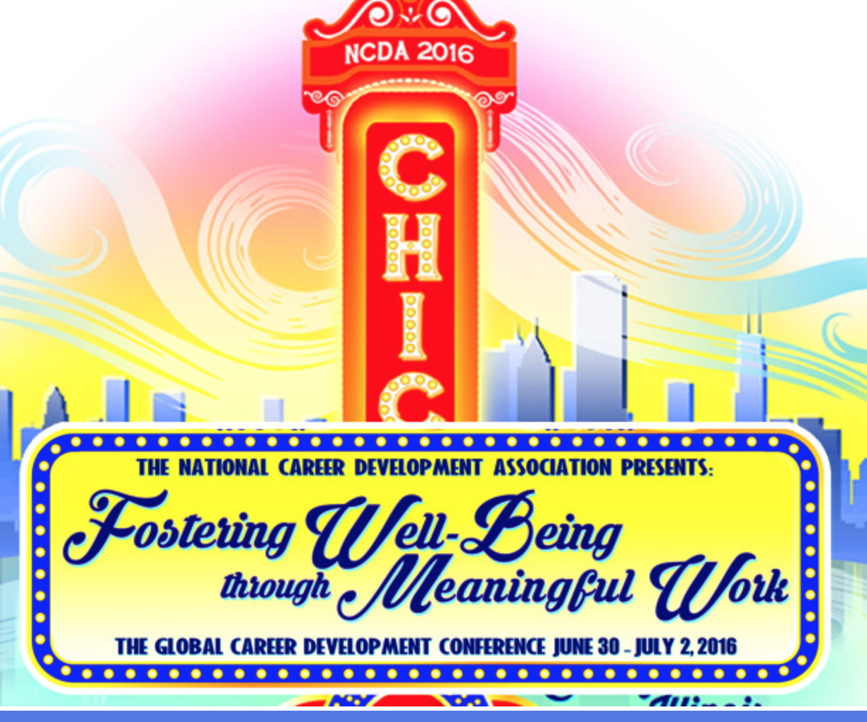
Professional Development
May 16-17
Florida State University
Tallahassee, FL
June 30-July 2
Hyatt Regency
Chicago, IL

Slide 36
References
Special issue: (2016). The connection between career development and mental health. Career Planning and Adult Development Journal, 32 (1).
American College Health Association. (2012). American College Health Association – National College Health Assessment: Fall 2012 reference group executive summary. Baltimore: American College Health Association.
American Psychiatric Association. (2013). Diagnostic and statistical manual of mental disorders (5th ed.). Washington, DC: Author.
Bernstein, D. A., Borkovec, T. D., & Hazlett-Stevens, H. (2000). New directions in progressive relaxation training: A guidebook for helping professionals. Westport, CT: Praeger Publishers.
Bullock, E. E., & Reardon, R. C. (2008). Interest profile elevation, big five personality traits, and secondary constructs on the Self-Directed Search. Journal of Career Assessment, 16, 326-338.
Corcoran, J. (2004). Building strengths and skills: A collaborative approach to working with clients. Re du/lib/unma/ reader.action?docID=10142449
Gadassi, R., Gati, I., & Dayan, A. (2012). The adaptability of career decision-making profiles. Journal of Counseling Psychology, 59, 612- 622. doi:10.1037/a0029155
Gadassi, R., Gati, I., & Wagman-Rolnick, H. (2013). The adaptability of career decision-making profiles: Associations with self-efficacy, emo- tional difficulties, and decision status. Journal of Career Assesssment. 40, 490-507. doi:10.1177/0894845312470027
Gati, I., Asulin-Peretz, L., & Fisher, A. (2012). Emotional and personality-related career decision-making difficulties: A 3-year follow up. The Counseling Psychologist, 40, 6-28. doi: 10.1177/0011000011398726
Hinkelman, J. M., & Luzzo, D. A. (2011). Mental health and career development of college students. Journal of Counseling and Development, 85, 143-147. doi: 10.1002/j.1556-6678.2007.tb00456.x
Holland, J. L., & Messer, M. A. (2013). SDS Form R. 5th ed. Professional Manual. Odessa, FL PAR

Slide 37
References, continued
Jacobs, S. J., & Blustein, D. L. (2008). Mindfulness as a coping mechanism for employment uncertainty. The Journal of Career Development Quarterly, 57, 174-180.
Kabat-Zinn, J. (2003). Mindfulness-based interventions in context: Past, present, and future. Clinical psychology: Science and Practice, 10, 144-156.
Lancaster, B. P., Rudolph, C. E., Perkins, T. S., & Patten, T. G. (1999). The reliability and validity of the career decision difficulties questionnaire. Journal of Career Assessment, 7, 393-413.
Lenz, J. G., Peterson, G. W., Reardon, R. C., & Saunders, D. E. (2010). Connecting career and mental health counseling: Integrating theory and practice. Retrieved from http://counselingoutfitters.com/vistas/vistass10/Article_01.pdf.
Meyer-Griffith, K., Reardon, R. C., & Hartley, S. L. (2009). An examination of the relationship between career thoughts and communication apprehension. Career Development Quarterly, 58, 171-180.
Morgan, F. N., Kadir, R. A., & Soheil, S. (2011). The relationship between stae and trait anxiety with career indecision of undergraduate students. International Education Studies, 4, 31-35.
Nauta, M. M. (2012). Temporal stability, correlates, and longitudianl outcomes of career indecision. Journal of Career Development, 39, 540-558. doi: 10.1177/0894845311410566
Niles, S. G., Amundson, N. E., & Neault, R. A. (2011). Career flow: A hope-centered approach to career development. Columbus, OH: Pearson.
Peterson, G. W., Leasure, K. K., Carr, D. L., & Lenz, J. G. (2009-10). The decision space worksheet: An assessment of context in career decision making. Career Planning and Adult Development Jounral, 87-100.
Saunders, D. E., Peterson, G. W., Sampson, J. P., Jr., & Reardon, R. C. (2000). The relation of depression and dysfunctional career thinking to career indecision. Journal of Vocational Behavior, 56, 288-298. doi:10.1006/jvbe.1999.1715
Rottinghaus, P. J., Jenkins, N., & Jantzer, A. (2009). Relation of depression and affectivity to career decision status and self-efficacy in college students. Journal of Career Assessment, 17, 271–285.
Saka, N., Gati, I., & Kelly, K. R. (2008). Emotional and personality-related aspects of career-decision-making difficulties. Journal of Career Assessment, 16, 403-424.

Slide 38
References, continued
Sangganjanavanich, F., &Headley, J. (2014-2015). Addressing the connection between career and mental health concerns: The utilization of career assessments. Career Planning and Adult Development Journal, 30, 198-208. http://www.samhsa.gov/data/sites/default/files/spot116-unemployment-mental-illness-2014.pdf
Sampson, J. P., Jr., Petereson, G. W., Lenz, J. G., Reardon, R. C., & Saunders, D. E. (1996). Career Thoughts Inventory. Odessa, FL: Psychological Assessment Resources, Inc.
Sampson, J. P., Jr., Peterson, G. W., Lenz, J. G., & Reardon, R. C. (1992). A cognitive approach to career services: Translating concepts into practice. The Career Development Quarterly, 41, 67-74.
Saunders, D. E., Peterson, G. W., Sampson, J. p., & Reardon, R. C. (2000). Relation of depression and dysfunctional career thinking to career indecision. Journal of Vocational Behavior, 56, 288-298. doi:10.1006/jvbe.1999.1715
Sweeney, M. L., & Schill, T. W. (1998) The association between self-defeating personality characteristics, career indecision, and vocational identity. Journal of Career Assessment, 6, 69-81.
Uthayakumar, R., Schimmack, U., Hartung, P. J., & Rogers, J. R. (2010). Career decidedness as a predictor of subjective well-being. Journal of Vocational Behavior, 77, 196-204.
Walker III, J. V., & Peterson,G. W. (2012). Career thoughts, indecision, and depression: Implications for mental health assessment in career counseling. Journal of Career Assessment, 20, 497-507. doi: 10.1177/1069072712450010
Watkins, C. E. (1984). Using early recollections in career counseling. Vocational Guidance Quarterly, 32, 271-276.
Zunker, V. (2008). Career, work, and mental health: Integrating career and personal counseling. Thousand Oaks, CA: Sage.

Slide 39
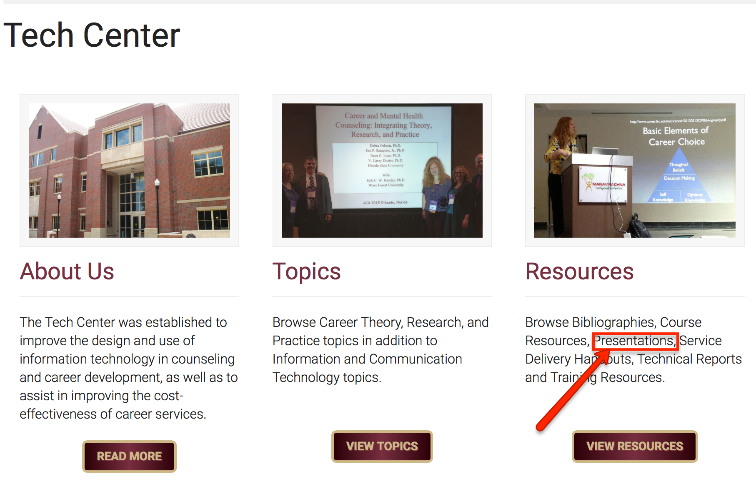
Slides Available
Email dosborn@fsu.edu for the link.
Or check at http://www.career.fsu.edu/Tech-Center

