Slide 1
Cognitive Information Processing Theory (CIP) in Action
Debra Osborn, Ph.D.
Florida State University
May 2017
Ohio Career Development Association
National Career Development Association
Notes:
Goal of this session is to provide theoretical foundations, research findings and practical strategies related to CIP

Slide 2
Today’s Goals:
Review theoretical foundation of CIP
Present practical CIP tools and strategies
Share research findings on CIP service delivery model

Slide 3
Why CIP?
The CIP differentiated service delivery approach has been used at the Florida State University Career Center for the past 42 years
Application to other higher education career centers and school career guidance programs in the US and worldwide

Slide 4
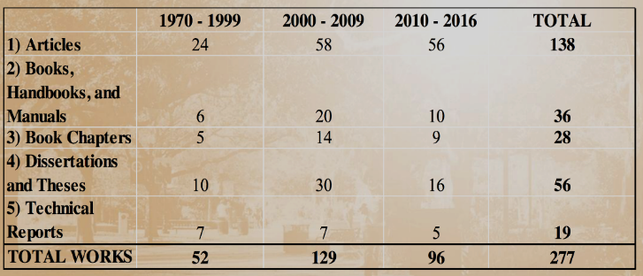
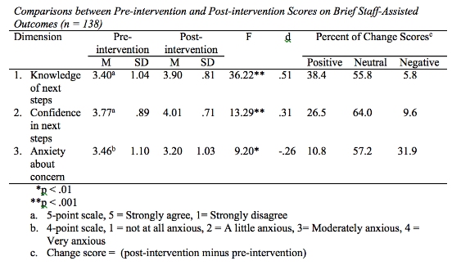
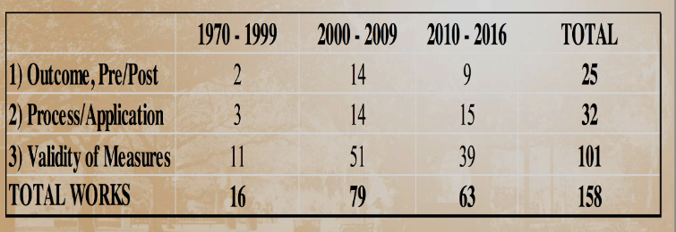
Research on CIP theory-based interventions
“Probably the most widely studied career interventions….cognitive information processing theory…”.
“Studies in Iceland and Switzerland provide empirical support for the efficacy of CIP-based interventions.”
Brown, S. (2015). Career intervention efficacy: Making a difference in people’s lives. APA Handbook of Career Interventions, Vol. 1.

Slide 6
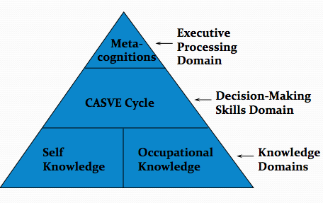
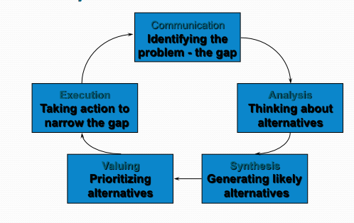
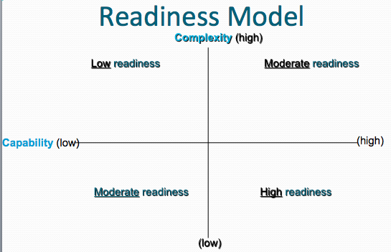
Theoretical Foundations: CIP Theory

Slide 7
CIP Pyramid Domains
Thinking about my decision making
Client Version
Knowing how I make decisions
(CASVE Cycle)
Knowing about myself
Knowing about my options

Slide 8
CASVE Cycle
Knowing I Need to Make a Choice
Knowing I Made a Good Choice
Communication
Implementing My Choice
Understanding Myself and My Options
Execution
Analysis
Choosing An Occupation, Program
of Study, or Job
Expanding and Narrowing My List of Options
Synthesis
Valuing

Slide 9
Readiness
The capability of an individual to make appropriate career choices taking into account the complexity of family, social, economic, and organizational factors that influence career development
Readiness also includes possessing adequate language skills and literacy skills for communication and learning
Source: Sampson, J. P., Jr., Reardon, R. C., Peterson, G. W., & Lenz, J. G. (2004). Career counseling and services: A cognitive information processing approach. Pacific Grove, CA: Brooks/Cole.
Notes:
Finally, in terms of understanding the client, we want to know how ready they are to make a career decision. t.

Slide 10
Accurate Assessment of Individual Needs
Capability concerns internal factors that make it more, or less, difficult to decide about occupational, educational, training, or employment options
Complexity concerns external factors that make it more, or less, difficult to decide, such as the family, society, the economy, or organizations
Notes:
We can determine readiness through self-report, observation and assessmen

Slide 11
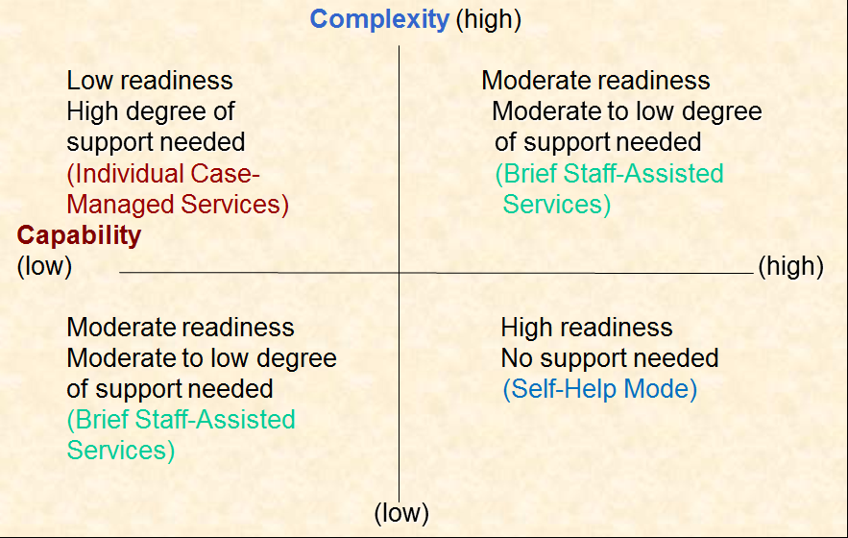
CIP Readiness Model
Notes:
Where is Leigh on this model? How do you know?

Slide 12
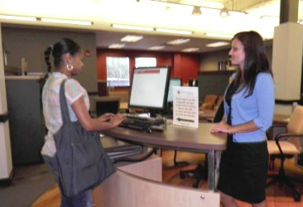
Differentiated Service Delivery Model
Individual Enters
Brief Screening
Self or Staff
Referral
Comprehensive Screening
Self-Help
Services
Brief
Staff-Assisted
Services
Individual
Case-Managed
Services
Complete differentiated model of delivering career resources and services
Notes:
Based on readiness, we can determine which service best meets the client’s needs

Slide 13
CIP in Practice - Roleplay
Have your two diagrams in hand
Our primary goal:
Identify the gap
Notes:
Have Leigh roleplay needing to make a career decision. Show how to incorporate CIP pyramid and CASVE. Stop once you’ve identified the gap.
Ask “What was the Gap?”

Slide 14
Once we know the gap…
We need to learn what’s impacting her decision.
We have a tool for that!

Slide 15
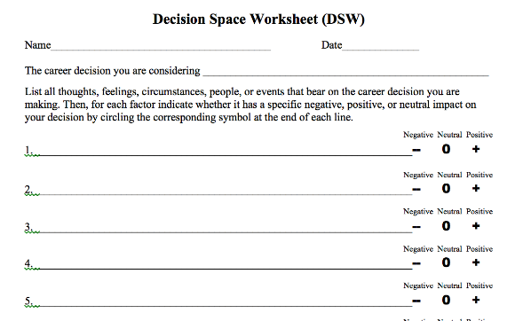
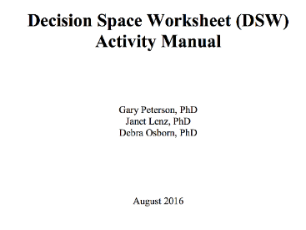
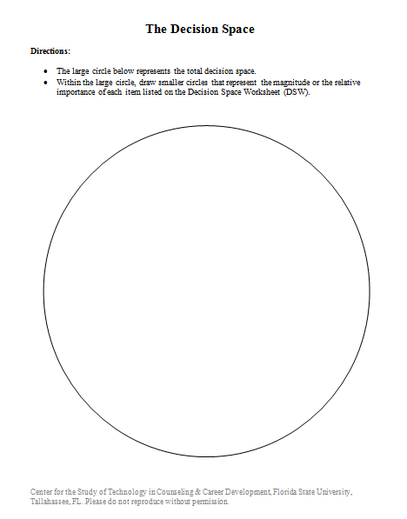
Decision Space Worksheet (DSW)
Assessing personal and social context
A measure of complexity
Available at: http://career.fsu.edu/tech-center/resources/service-delivery-handouts
or http://tinyurl.com/fsu-handouts
Peterson, G. W., Leasure, K. K., Carr, D. L. & Lenz, J. G. (2010). The Decision Space Worksheet: An assessment of context in career decision making. Career Planning and Adult Development Journal, 25, 87-100.
Notes:
This will also help us begin to determine readiness.

Slide 16
Purpose of the Decision Space Worksheet (DSW)
Cognitive mapping task
Helps clients reveal thoughts, feelings, persons, circumstances associated with career decision
Helps clients prioritize importance of contextual influences
Can be used with middle school through college level students and adults

Slide 17
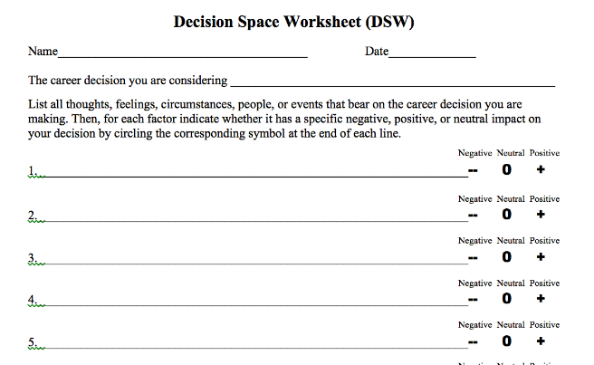
Let’s Do It! (Partner Alert)
Think of a decision related to your career.
Write out all of the factors that are impacting this decision.
Circle whether each is positive, negative, or neutral.
On the backside, create a visual representation of each of these.
Notes:
Decision related to your career – career change, retirement, relocation, a task or project you’d like to take on, a career goal you have, etc.

Slide 18
Partnering
What was this experience like for you? Thoughts/feelings? May I ask you some questions about your responses?
State the decision that your partner indicated.
Ask: “Would you like to add anything to this statement?”
Look at the list of elements and valences.
Ask: “What is your impression of this list?”
“How does each item affect your career decision? Are some of the valences slightly stronger than others?”
Look at diagram and note the top 3. Look for themes.
Are they all affective, or concern areas of interest, or suggest a negative self-concept, etc.?
Summarize
Notes:
As you go through, consider how each element influences the career decision. Does it interfere or facilitate, and how?

Slide 19
Sample Summary
“So, from this, you’ve shared that in figuring out your major, there are three main elements that are impacting your choice: cost/time required, unsure of what majors might interest you, and fear of making the wrong choice. On the plus side, your parents are very supportive, you’ve got a strong GPA, and have some time to figure this out. Would you agree with this? Would you add anything to what I just said?”
Notes:
Now tell them to partner up and go through it. 5 minutes for each. Go back to previous slides for sample questions.

Slide 20
Group Debrief
What was the activity like?
Which questions were most helpful?
Where did you get stuck?
What other questions would you add?
What might you add?
What issues can you see potentially emerging from this activity?
Notes:
(

Slide 21
Types of Issues Revealed
Cognitive distortion
Disabling emotions
Financial
Family
Education
Interests
Self doubt
Employment
Quality of life
Notes:
Often highlights the GAP

Slide 22
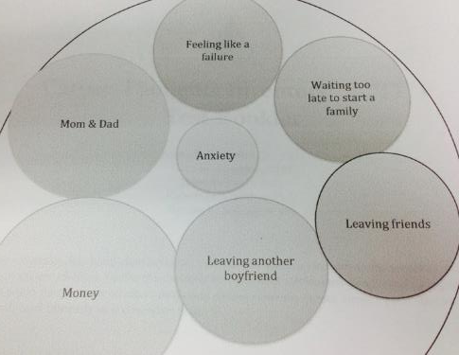
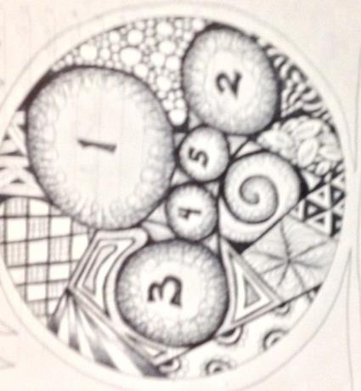
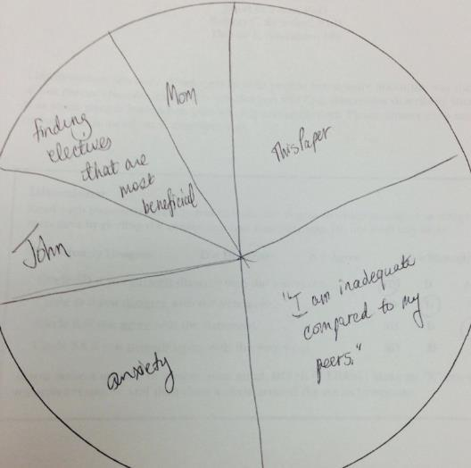
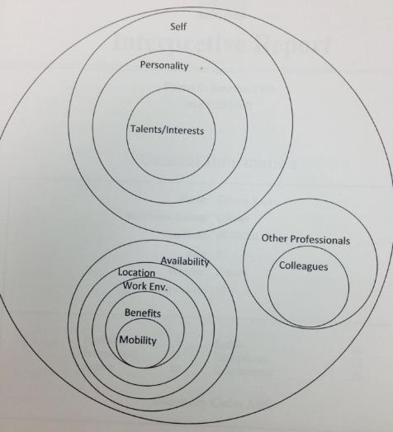
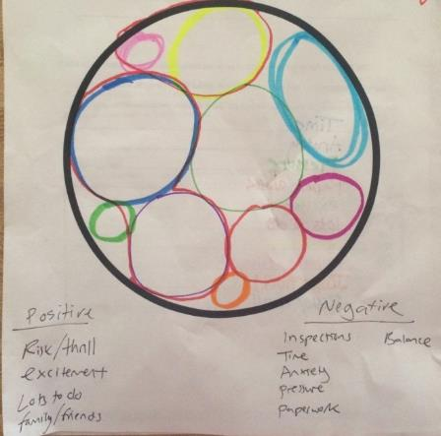
Sample DSWs
Notes:
Also consider the white space, whether they go outside the lines (artistic v. problems following direction?), elaborate design (artistic, or OCD?), bulls-eye – this is the core issue

Slide 23
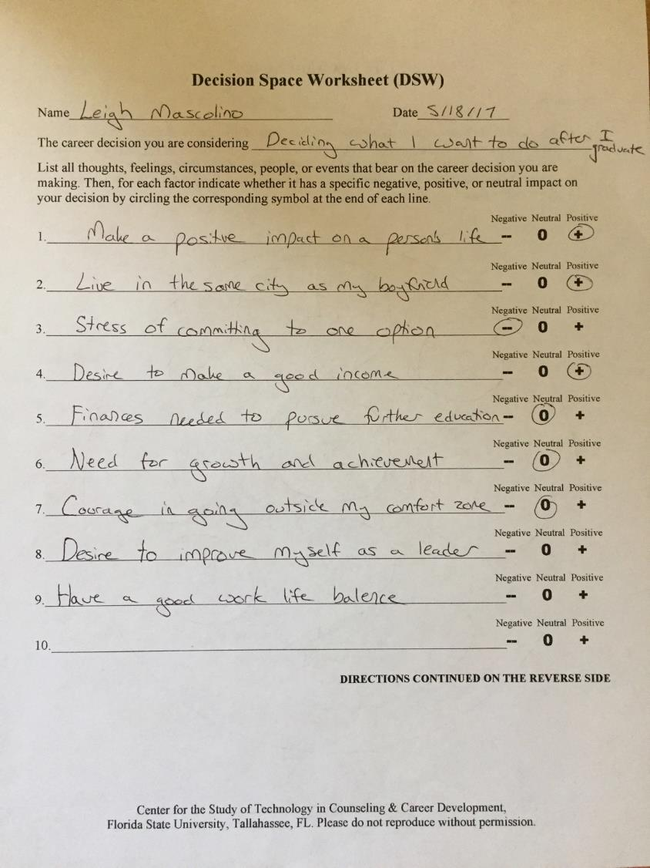
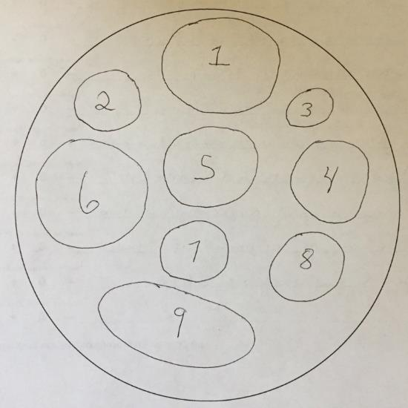
Leigh’s DSW
Notes:
2. Make a positive impact in a person’s life
9. Have a good work-life balance
6. Need for growth and achivement

Slide 24
Next Steps with the DSW
Further readiness assessment?
Develop the ILP
Readiness assessment
Career assessment
Options information
Referrals for mental health concerns

Slide 25
Recap of Leigh’s Situation
What is the gap?
Location in the pyramid
Location in CASVE Cycle
Readiness
Considerations from DSW exercise

Slide 26
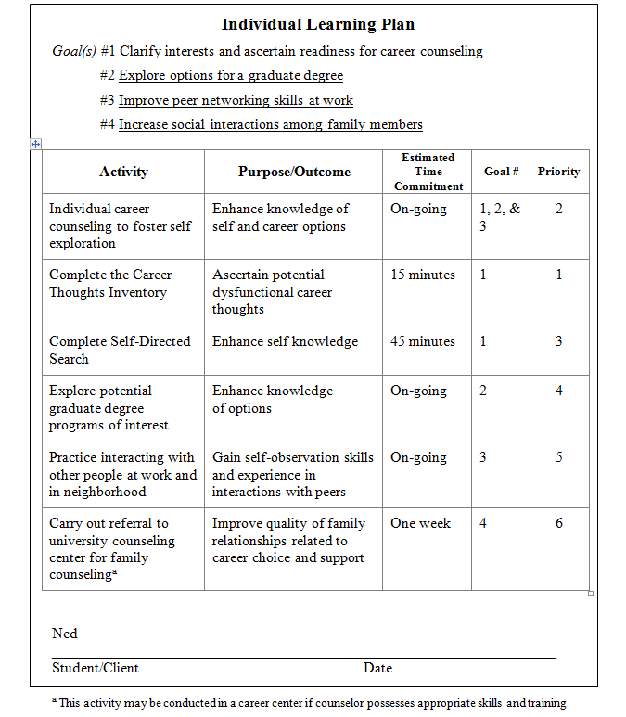
Individual Learning Plan
Notes:
Before we develop Leigh’s, let’s talk brainstorm possible generic interventions for the CIP Pyramid.

Slide 27
CIP Strategies & Interventions

Slide 28
Practical Strategies for Building Self-Knowledge?
Notes:
Assessments, checklists, autobiographies, journaling, CACGs, card sorts, etc.

Slide 29
Practical Strategies for Building Options Knowledge?
Notes:
ONET, Occupational Outlook Handbook, CACGs, informational interviews, websites, Glassdoor, experiential

Slide 30
Practical Strategies for Building Decision Making Skills?
Notes:
Guide to Good Decision Making; CASVE Handout; Pro/Con Worksheet;

Slide 31
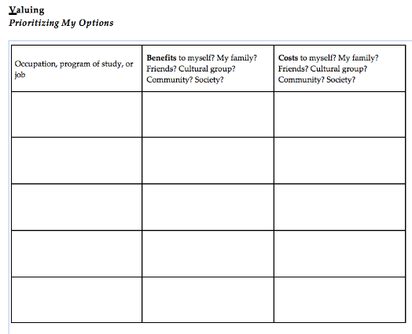
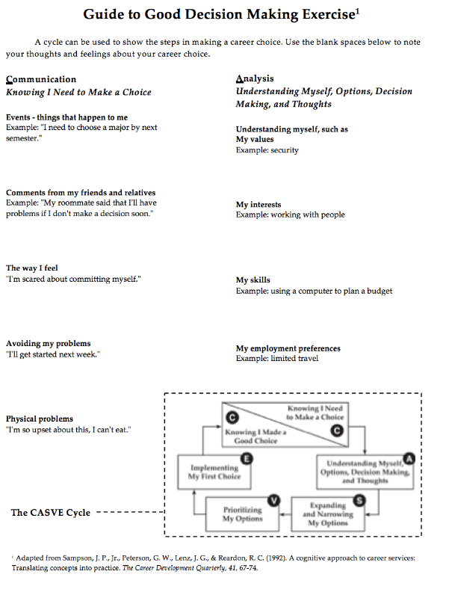
EXAMPLES

Slide 32
Practical Strategies for Assessing Metacognitions (Self-Talk)?
Notes:
Listen; more formal assessment

Slide 33
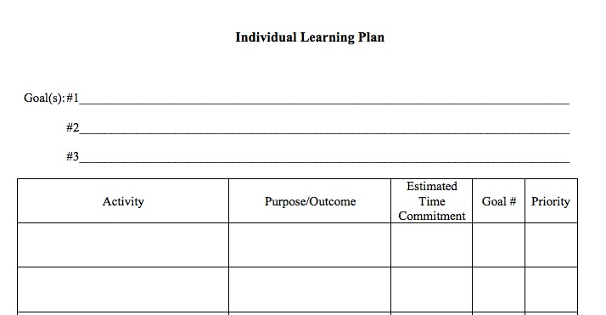
Leigh’s ILP
Notes:
Based on what we know, what might be the goals? For goal #1, what might be an intervention, etc.?
What about the metacognitive piece? What if we decided we needed a more formal assessment?

Slide 34
Career Thoughts Inventory
Measures dysfunctional career thoughts
Why???
Based on Cognitive Information Processing (CIP) theory
DCTs make up over 60% of the variance in career
indecision.

Slide 35
Impact of negative thinking?
Negative
They color:
A client’s perception of interests and abilities
Whether they think a certain career is a good choice
How the client evaluates options
How the client make career decisions
Negative thoughts trickle down into all other components of career decision making
Thinking
About
Decisions
Negative
Decision-
Making
Self-
Knowledge
Knowledge
About
Options

Slide 36
Career Thoughts Inventory (CTI)
Self-administered
Objectively scored
48-Item measure of dysfunctional thoughts in career choice
3 Subscales:
Decision Making Confusion
Commitment Anxiety
External Conflict

Slide 37
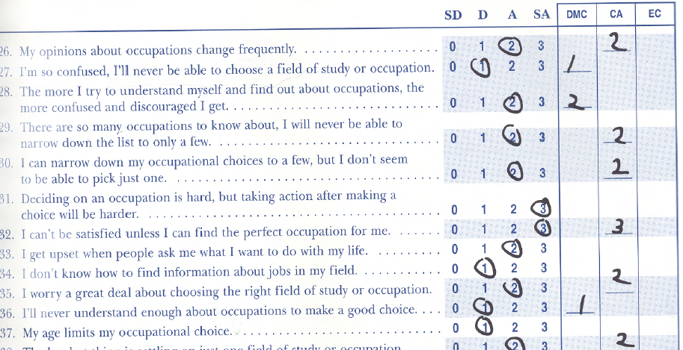
Snapshot of CTI

Slide 39
Question 1
In the CTI profile shown, this client’s overall profile suggests:
Low amounts of dysfunctional thinking
An average amount of dysfunctional thinking
Moderately high amounts of dysfunctional thinking
High levels of dysfunctional thinking

Slide 40
Question 2
In which area should the counselor focus?
All areas
Decision Making Confusion
Commitment Anxiety
External Conflict

Slide 41
Question 3
Which of the following is this client also experiencing?
Anxiety
Depression
Career indecision
None of the above

Slide 42
Question 4
Which of the following item is most likely related to her highest area of concern?
I’m afraid I’m overlooking an occupation.
I get so depressed about making a decision that I can barely get started.
My age limits my occupational choice.
Whenever I become interested in something, important people in my life disagree.
Reason for your answer?

Slide 43
Question 5
Which is the best reframe for
“My age limits my occupational choice”?
It may make a difference to some, but others will see the benefit of my experience.
If I don’t get a job offer, I can always file an age discrimination grievance.
My age does not limit my choices.
Nothing – it’s the truth.
Reason for your answer?

Slide 44
Mental health constructs directly correlated with dysfunctional career thoughts
☑indecision
☑neuroticism
☑anxiety
☑angry hostility
☑depression
☑hopelessness
☑impulsivity
☑vulnerability

Slide 45
Sample Items
Finding a good job is just a matter of luck.
I’m embarrassed to let others know I haven’t chosen a career.
I know what job I want, but someone’s always putting obstacles in my way.
Notes:
So the challenge is….

Slide 46
Case Study - Carolyn
Carolyn is a second semester Latina freshman at your university.
For as long as she can remember, she’s wanted to be a doctor, just like her grandmother.
When asked why, she says she wants to help people.
She was consistently on the Dean’s list in high school, and she’s received a scholarship for a pre-med scholarship.
She wants to be known as a medical leader within her community and serve as a mentor to other Latina high school students to go into medicine.
However, during her first semester, she struggled to make C’s in her science courses, despite hours of studying and working with a tutor.
During this current semester, she’s finding herself bored with her science courses, but enjoying her introduction to psychology course.
She says she’s terrified about failing out, and what everyone will think.
She’s talked with her parents about the dilemma, and while they say they’ll support anything she wants to do, they are quick to point out that there are lots of psychology majors flipping burgers at McDonalds.
Her CTI Scores include Total (T=70), Decision Making Confusion (T = 71), Commitment Anxiety (T=51), External Conflict (T=80).
Notes:
Refer to handout

Slide 47
Consider…
Where is the main problem located in the CIP pyramid? What proof do you have of this?
Where is the client in the CASVE cycle? What is the evidence for this?
Are dysfunctional thoughts evident? If so, in which area (decision-making confusion, commitment anxiety or external conflict)? What is the evidence for this?
What is the client's level of readiness, and what type of support is needed? What is the evidence for this?
What type of interventions would you recommend, and in what order? Give support for the interventions you suggest.
Notes:
Introverts –do on your own, we’ll process as a large group
CIP pyramid:
Self-knowledge needs:
knows her values
may not know her skills or interests
Occupational knowledge
Not clear on this
Decision making
Jumping right to next option
T score high
DCT
Worried about others’ opinions
T score 2 SDs above mean in 2 areas
CASVE Cycle
Analysis – hasn’t expanded options – still needs to identify skills, interests
DCTS:
Yes – 2 SDs above mean in in 2 areas
DMC, EC
Statements she makes
READINESS:
Moderate
She is capable (med scholarship); decision making confusion
High complexity
INTERVENTIONS:
Cognitive restructuring
Walk through CASVE Cycle

Slide 48
How can we go from this…?
I’m not smart enough
to go into that field.
I’ll never be
able to decide
I should have made
up my mind about
a career by now.
If I change my mind now,
Everyone will think I
Wasted my time & money.
I can’t make
good decisions.
My interests
are always
changing
I’m so anxious,
I know I’ll make the wrong choice.
I have to make
the right decision.
I always regret
the decisions I
make.
There are too many options
to choose from; it’s too overwhelming
to even get started.

Slide 49
…To this???

Slide 50
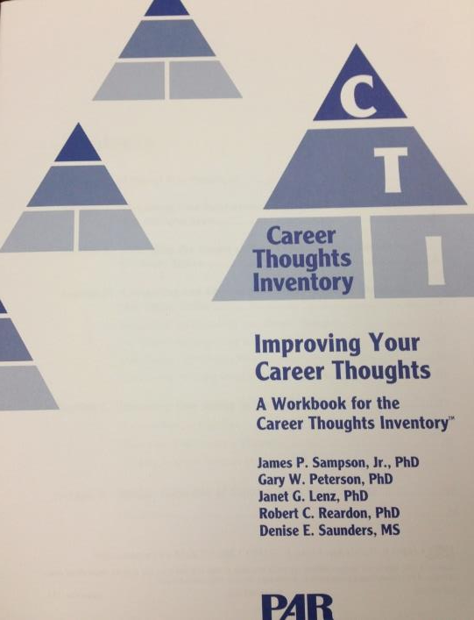
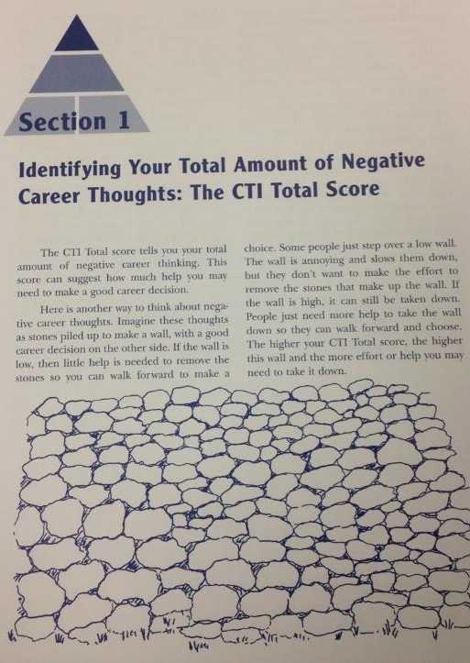
CTI Workbook

Slide 51
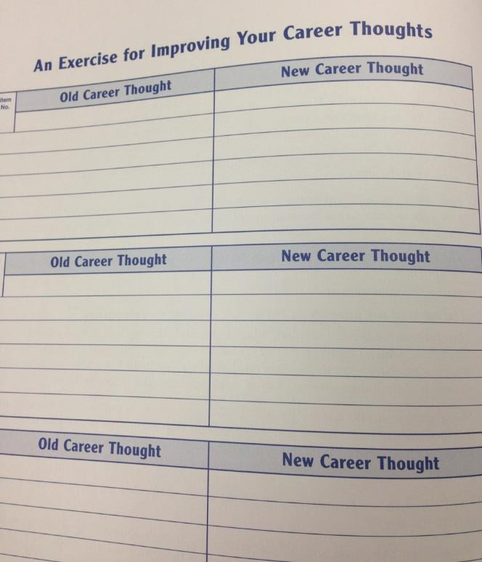
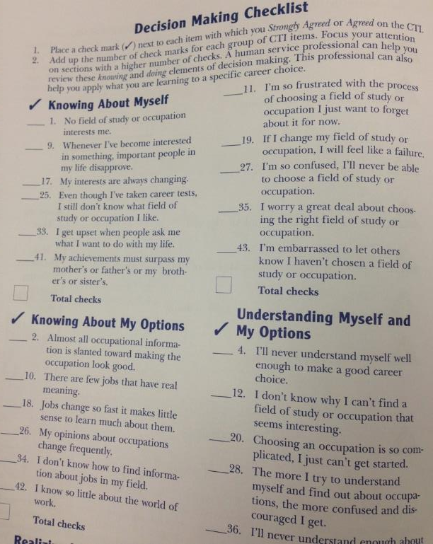
CTI Workbook

Slide 52
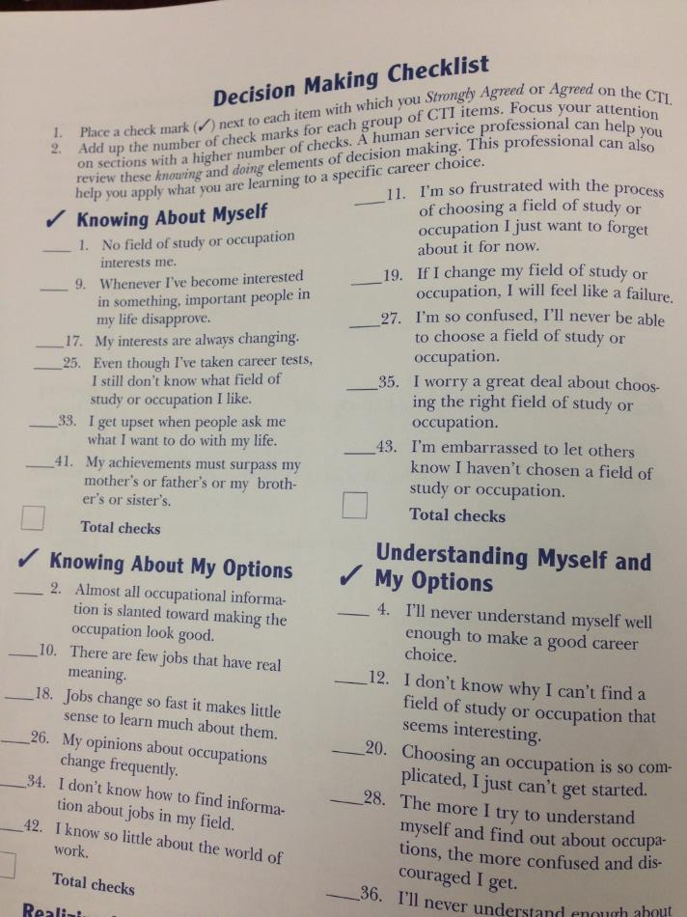
CTI Workbook

Slide 53
Casting Off Negative Thoughts
Catch the negative thoughts when they come.
Ask:
What’s the proof for this?
Is there an underlying theme?
E.g., Fear of failure, perfectionism
How does this thought make me feel?
Reframe the thought into something more positive, truthful and productive.
Repeat process as necessary.

Slide 54
Dysfunctional Thinking Cycle
Dysfunctional
Thought
Emotional
Response
Reinforce-
ment
Cycle of Dysfunctional Thinking
Misguided
Behaviors
Conse-quence

Slide 55
Cognitive Distortions
Arbitrary inference | a tendency to infer a relationship of external events to oneself in the lack of any apparent connection; dichotomous (all or nothing) thinking
Selective abstraction | tendency to draw conclusions about another person or situation, which may be true, and then generalizing these conclusions to situations where they may not be true
Overgeneralization | a tendency to construct the worst possible situation from an undesirably event
Magnification or minimization | the individual selects one or more details of a situation and conceptualizes the whole from those few details
Personalization | the process of drawing a conclusion without data to support that conclusion or even with data contrary to that conclusion
Catastrophizing | a tendency to either overestimate or underestimate the significance of an event

Slide 56
DIBS Method
Dispute Irrational Beliefs (Ellis)
Identify the irrational belief.
Ask: Can I rationally support it?
Ask: What evidence exists of the falseness of my belief?
Ask: Is there any evidence for the trueness of my belief?
Dispute:
What are the worst things that could happen if my belief is true?
What are good things that could happen if my belief is true?
10 minutes a day
“So what if…?” versus “What if?”
Identify, Challenge, Alter, Act
Notes:
Identify: becoming aware of negative thoughts
Challenge: what’s the proof for these thoughts, and are they helping or hindering you?
Alter: if hindering and/or untrue, change the thoughts
Act: do what you need to do to make good choices

Slide 57
Reframing
DCT
Theme
Feeling
Reframe
I can’t make good decisions.
Fear of failure; lack of knowledge
Inadequate, stupid, overwhelmed
I can learn how to make better decisions.

Slide 58
Reframing Exercise
Negative thought | Theme | Feeling | Reframe
Notes:
On handout

Slide 59
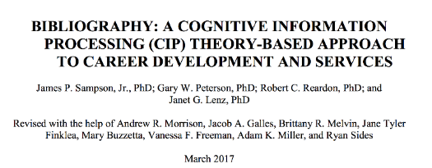
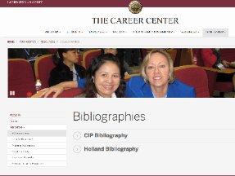
Summary
CIP offers simple structures to the sometimes chaotic and complex nature of career decision making.
CIP provides a guide for understanding where a client is and for pinpointing relevant interventions.
CIP offers tools to aid career practitioners in their work.
CIP continues to generate research and has an ongoing bibliography.

Slide 60
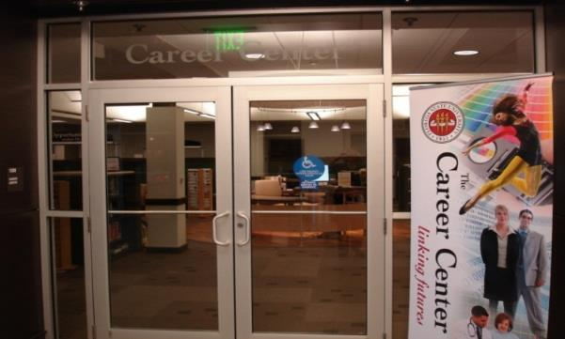
For More Information
www.career.fsu.edu/techcenter
dosborn@fsu.edu

