Slide 1
PRC Express Workshop: Landing an Internship

Slide 2
Overview:
Outcomes
5 tips
Next steps
Questions

Slide 3
Learning Outcomes and Career Readiness Competencies:
Learning Outcome: Understand timing, process and tips to successfully land an internship
Related competencies:
Career Management
Critical Thinking/Problem Solving

Slide 4
Tip #1: Understand what an internship is
Career-related experience
Paid or unpaid
Typically lasts one semester/at least 60 hours
Usually part-time
Opportunity to receive either academic credit through your college or recognition through The Career Center
Notes:
For those new to what internships are, explain briefly what they are and how they differ from other experiential learning opportunities.

Slide 5
Tip #2: Know Yourself
What type of experience are you looking for?
Related to intended career field vs. trying something new?
Paid vs. unpaid?
Time commitment?
Where do you want to complete the internship?
What are the skills you want to build?
Notes:
Important to do self-assessment on what the student is looking for and skills they hope to gain, values, and limitations.

Slide 6
Tip #3: Know the Process
The process includes:
Having idea what you’re looking for and where
Creating strong resume/cover letter
Using resources to find internships
Applying to internships
Interviewing
Sending a thank you note
Following up
Typically, this process can take 12-16 weeks from submitting an application to actually starting. Think about when you want to begin your internship and then back up 3-4 months.
Notes:
Show you’ve done your homework!
What are the most important characteristics for success in this role?
What are the priorities for the job?
What are 3 things you find most challenging about your job?

Slide 7
Tip #4: Don’t Limit yourself
There are many different platforms to find internships. Examples include:
Handshake
Search Internships
LinkedIn
Networking
Notes:
There are so many ways to find internships!
The Career Center has many resources, including but not limited to Handshake, on our website. There are other online platforms like LinkedIn, Goin Global, and ones more tailored to certain career paths.
Networking is huge. It makes the difference between just being a paper/electronic application and actually putting a face to the name or endorsement from a friend/colleague/etc.

Slide 8
Tip #5: Customize and Apply
When applying to multiple internships, customize your resume (and definitely your cover letter!) to each application. Customization includes:
Relevant experience/skillsets
Coursework/projects
Campus/Community Involvement
Leadership
You won’t get the internship if you don’t submit an application!
Notes:
Most critical part.
Typically, men are more likely to apply for positions if they match at least 50% of the qualifications listed. For women, it much closer to 80+%.

Slide 9
Next steps
Just beginning? Look for internships and other experiential learning opportunities on Handshake
Meet with your Career Liaison or with a Career Center staff member
Get your experience recognized through the Experiential Recognition Program
Notes:
Connect with companies
Ask for business cards
Practice my elevator speech
What if none of the companies are hiring?

Slide 10
Questions
When should I start looking for internships?
How many internships should I have before I graduate?
Notes:
FAQs: Add in frequently asked questions for your topic
-timeline?
-how many to apply to?
-how to get hired full-time after graduation?

Slide 11
Professional Clothing Closet
Students can obtain FREE professional and business casual attire appropriate for:
View hours of operation at career.fsu.edu/ClothingCloset

Slide 12
Drop- in Career Advising
Monday – Friday, 9 a.m. - 4:30 p.m.
Extended Tuesday hours, 9 a.m. - 8 p.m.
(Fall and Spring semesters only)
Closed Fridays, 1:30 - 2:30 p.m. (Fall & Spring semester)
Visit career.fsu.edu/CareerSpots to learn more!

Slide 13
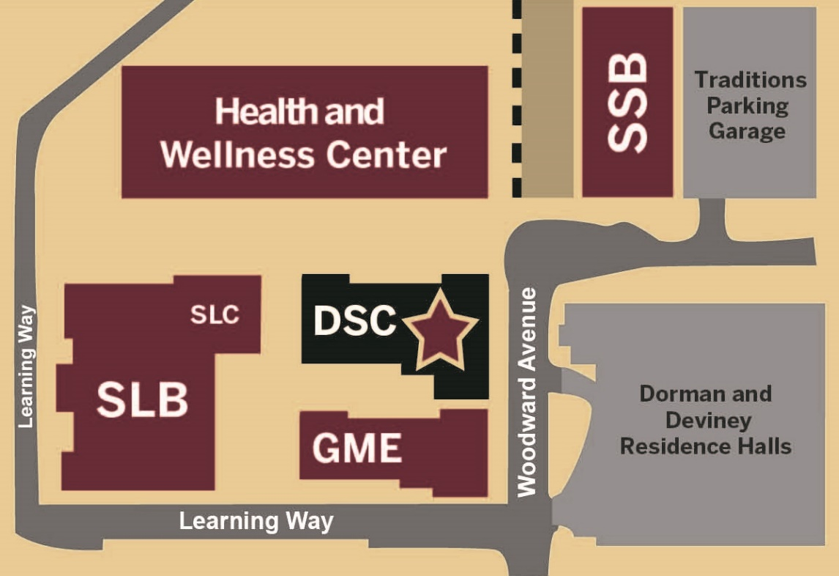
The Career Center
Located in the Dunlap Success Center at the corner of Learning Way and Woodward Avenue
Career.fsu.edu

Slide 14
Complete the survey to confirm your attendance
PRC workshop survey
*This will count towards your completion of the ProfessioNole Ready Certificate
Career.fsu.edu

