Slide 1
The Career Outcome Metacognitions Survey
Michael J. Morgan Jr., M.S.
Debra S. Osborn, Ph.D.

Slide 2
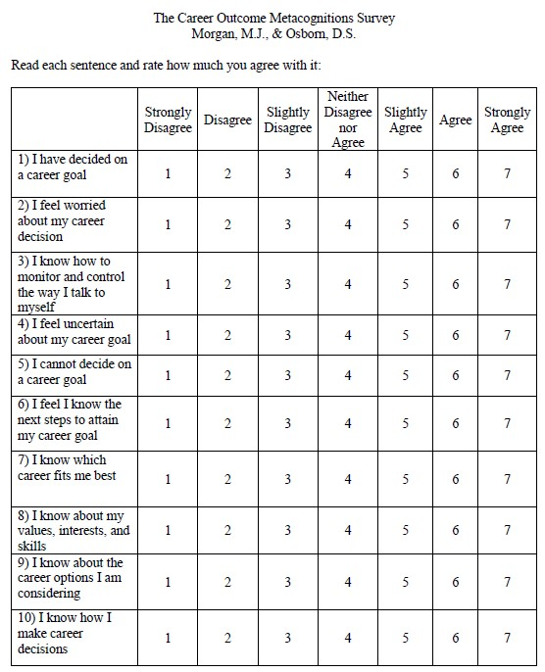
Key Message
We have created a free resource that can be used to both assess the level of intervention needed and track client progress during career decision making.

Slide 3
Learning Objectives
Describe how metacognition and self-regulation influence career decision-making
Differentiate between metacognitive experiences and beliefs
See the psychometric properties of the COMS
Learn how to score/interpret the COMS
Apply the COMS to potential clients

Slide 4
The Cycle of Self-Regulation
Action
Awareness
Judgement
Control
Preparation
Reflection
(Schunk & Greene, 2019)

Slide 5
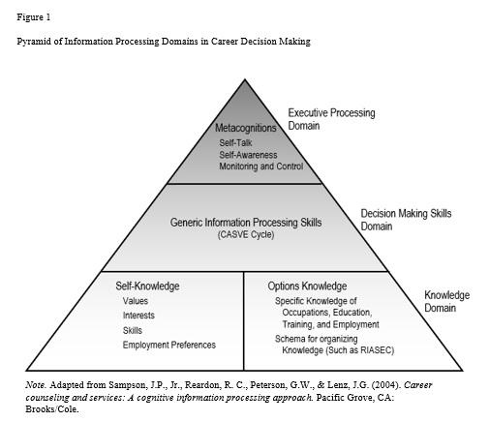
Cognitive Information Processing Theory

Slide 6
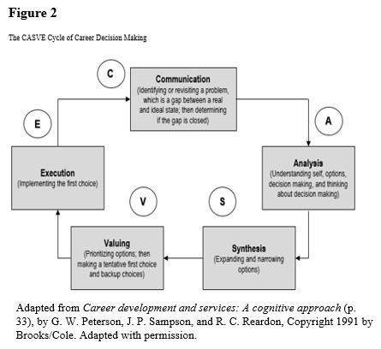
Cognitive Information Processing Theory

Slide 7
Cognitive Behavioral Therapy
Cognition
Behavior
Emotion

Slide 8
Cognitive Behavioral Therapy
Cognition
“I like speech pathology”
Behavior
Emotion

Slide 9
Cognitive Behavioral Therapy
Cognition
“I like speech pathology”
Interest
Behavior
Emotion

Slide 10
Cognitive Behavioral Therapy
Cognition
“I like speech pathology”
Planning
Interest
Behavior
Emotion

Slide 11
Meta Cognitive Therapy
Meta Cognition
Cognition
Behavior
Emotion

Slide 12
Meta Cognitive Therapy
“I will make a bad choice”
Meta Cognition
Cognition
“I like speech pathology”
Indecision
Fear
Behavior
Emotion

Slide 13
What is Metacognition?

Slide 14
What is Metacognition?
Thinking about Thinking

Slide 15
What is Metacognition?
Thinking about Thinking
Metacognitive Knowledge
Knowledge and beliefs about factors that affect the process and outcome of cognition.

Slide 16
What is Metacognition?
Thinking about Thinking
Metacognitive Knowledge
Metacognitive Experiences
Knowledge and beliefs about factors that affect the process and outcome of cognition.
Any conscious or cognitive affective experiences that accompany and pertain to any intellectual enterprise.

Slide 17
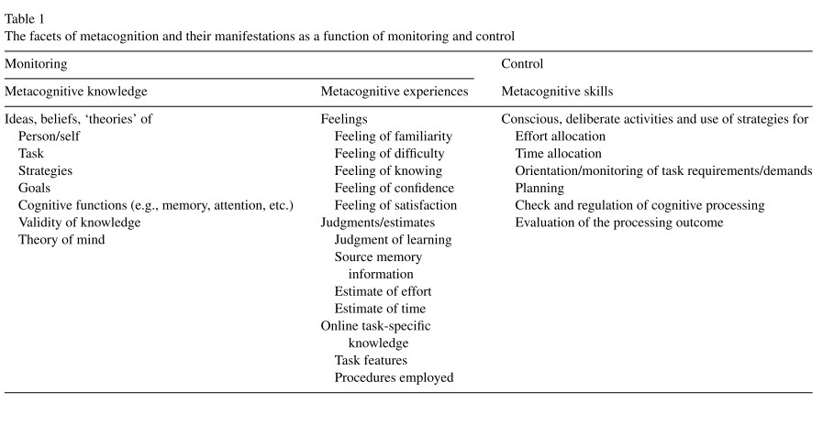
(Efklides, 2011)

Slide 18
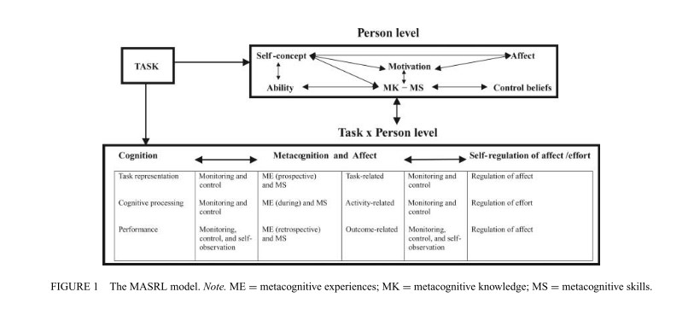
Metacognitive experiences link the person and the task.
(Efklides, 2011)
Notes:
Do you have a better image? This one is fuzzy.

Slide 19
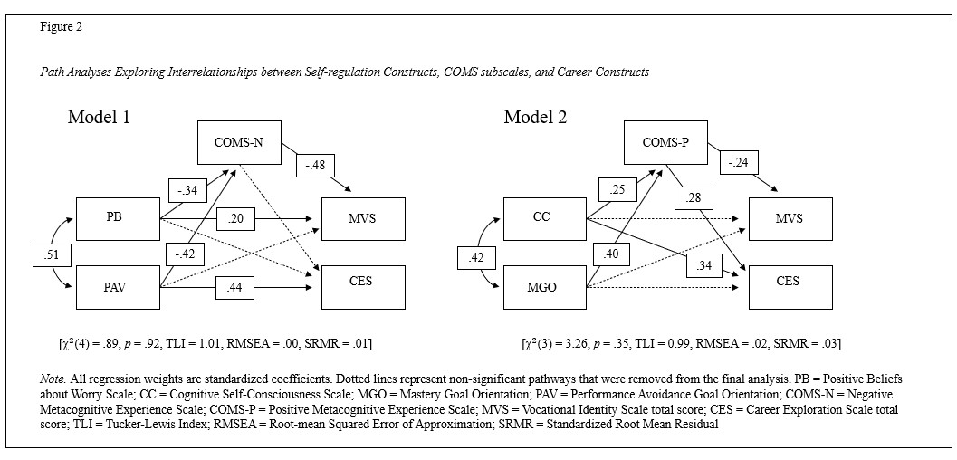
(Morgan & Osborn, 2021)

Slide 20
What does Metacognition have to do with MY clients?

Slide 21
What does Metacognition have to do with MY clients?
Maladaptive metacognition is associated with:
Increased Worry
Trait Anxiety
MDD
GAD
OCD
SCZ
(Sun et al., 2017; Wells & Cartwright, 2004)

Slide 22
What does Metacognition have to do with MY clients?
Maladaptive metacognition is associated with:
Increased Worry
Trait Anxiety
MDD
GAD
OCD
SCZ
Career Metacognition is associated with:
Worry
Depression
Trait Anxiety
State Anxiety
Motivation to Achieve
(Sun et al., 2017; Wells & Cartwright, 2004)
(Morgan & Osborn, 2021; Saunders et al., 2000)
Notes:
Do we want to say negative career metacognition?

Slide 23
CIP-based Assessments of Metacognition

Slide 24
CIP-based Assessments of Metacognition
Career Thoughts Inventory
Dysfunctional Career Thoughts
3 Subscales:
Decision Making Confusion
Commitment Anxiety
External Conflict
48 Items
PAR Copyright

Slide 25
CIP-based Assessments of Metacognition
Career Thoughts Inventory
Dysfunctional Career Thoughts
3 Subscales:
Decision Making Confusion
Commitment Anxiety
External Conflict
48 Items
Strong Psychometrics
PAR Copyright
Career Outcome Metacognitions Survey
Metacognitive Experiences
2 Subscales:
Positive Valence/MK
Negative Valence/ME
10 Items
Developing Psychometrics
Open Source

Slide 26
Scoring and Tentative Decision Matrix Cutoffs

Slide 27
Positive Metacognitions
High
(> 43)
Low
(<31)
Client has sufficient information to make a decision, and negative metacognitions are probably not hampering decision making
Client lacks sufficient information to make a decision, and negative metacognitions are probably not hampering decision making
High
(>13)
Self-Help; Not Likely to Need Help
Brief Help; Career Exploration; Career Center Referral
Negative Metacognitions
Client has sufficient information to make a decision, and negative metacognitions are probably hampering decision making
Client lacks sufficient information to make a decision, and negative metacognitions are probably hampering decision making
Low
(<7)
Individual Counseling
Individual Counseling and Career Center Referral

Slide 28
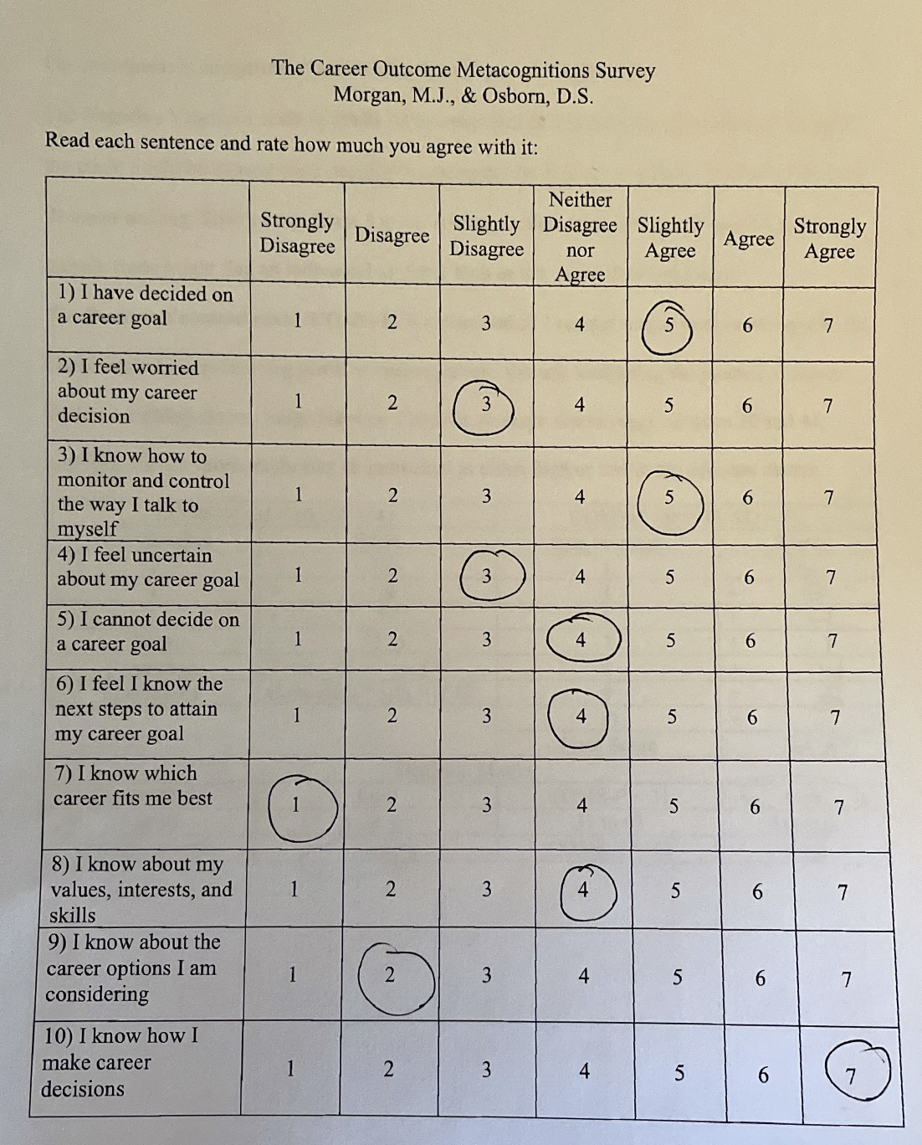
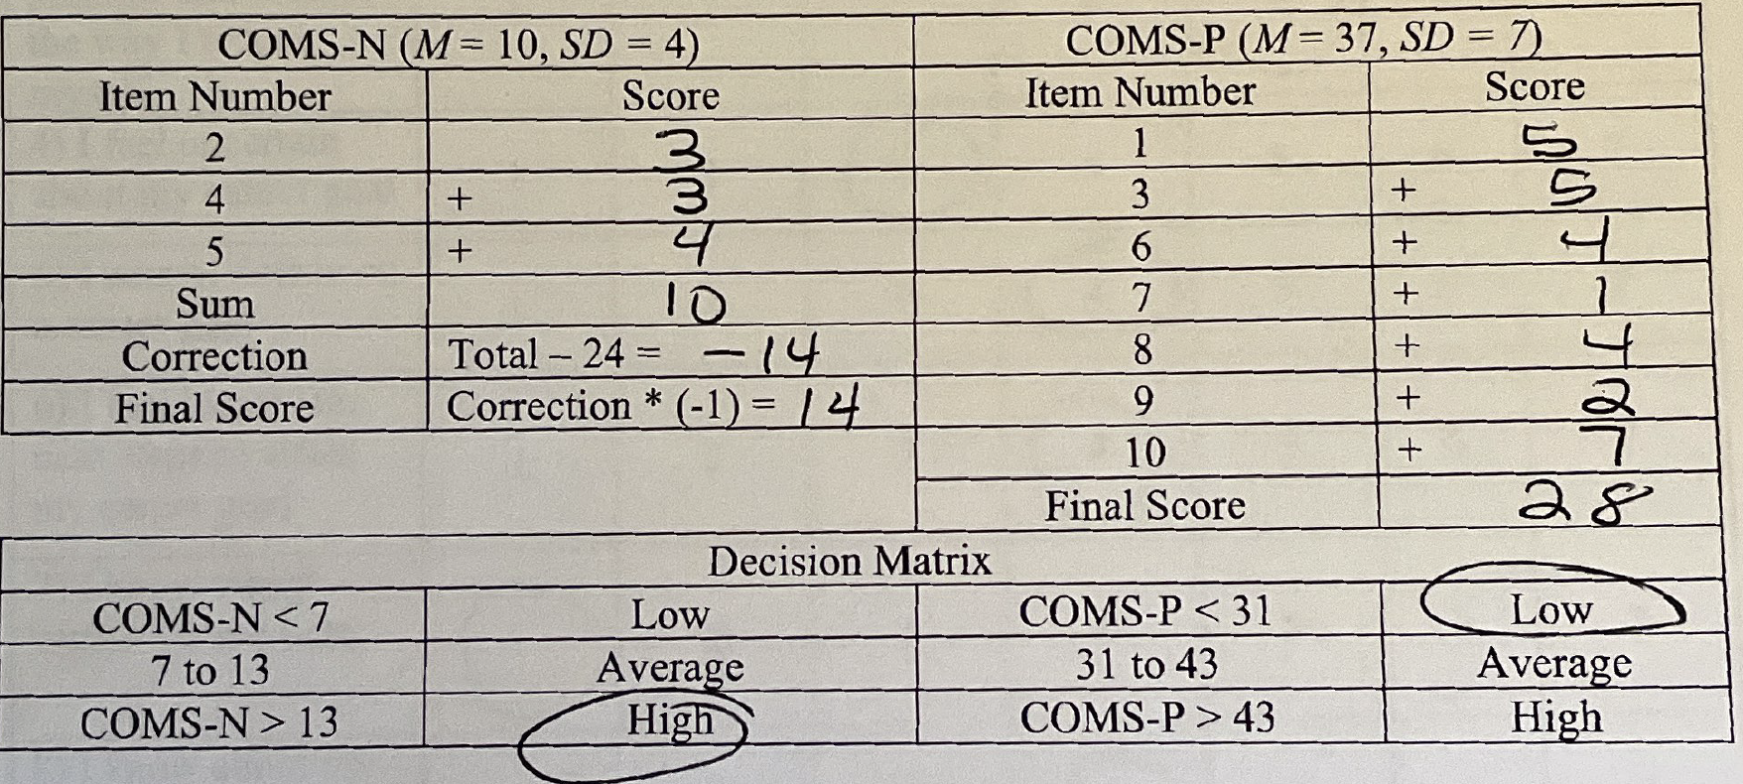
Case Study: Robert
Robert, 50 years old, was laid off from his position due to company cutbacks. He looked for similar work but reported having difficulty getting excited about going back into the same “same-old,” but is excited about exploring how he might use his interests and skills in a different way.

Slide 29
Positive Metacognitions
High
(> 43)
Low
(<31)
Client has sufficient information to make a decision, and negative metacognitions are probably not hampering decision making
Client lacks sufficient information to make a decision, and negative metacognitions are probably not hampering decision making
High
(>13)
Self-Help; Not Likely to Need Help
Brief Help; Career Exploration; Career Center Referral
Negative Metacognitions
Client has sufficient information to make a decision, and negative metacognitions are probably hampering decision making
Client lacks sufficient information to make a decision, and negative metacognitions are probably hampering decision making
Low
(<7)
Individual Counseling
Individual Counseling and Career Center Referral

Slide 30
Possible Interventions
Discuss the extreme items and the self-talk item:
#7 I know which career fits me best (rated as strongly disagree)
#10 I know how I make career decisions (rated as strongly agree)
#3 I know how to monitor and control the way I talk to myself (rated as slightly agree)
Explore what options Robert has been considering.
What information would he need to make him feel more certain about his choice?
Connect with relevant resources
Self-assessments/CACGS to see options related to values, interests, skills
Occupational information such as O*Net to build options knowledge
Networking strategies to explore local opportunities
Resume writing to highlight transferable skills
Consider individual plan for multiple steps
Notes:
Tell me more about that. Tell me about your decision making. You said you only slightly agree with this – tell me more.

Slide 31
Case Study: Tina
The client is a 23-year-old African American female that identifies as a cisgender heterosexual female. The client reported stress associated with a career decision: she recently decided to change her major but worries she has made the wrong choice. Her change of major will still lead her to her career choice of medical school, but she always feels nervous and believes there is nothing she can do to change that. She recently did poorly on a practice MCAT test and stated she knows she can do better if she just keeps trying to figure out what went wrong.

Slide 32
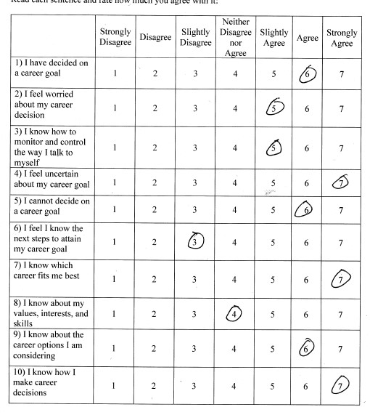
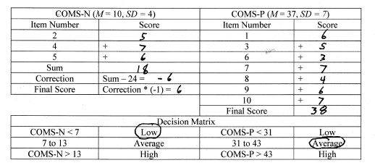

Slide 33
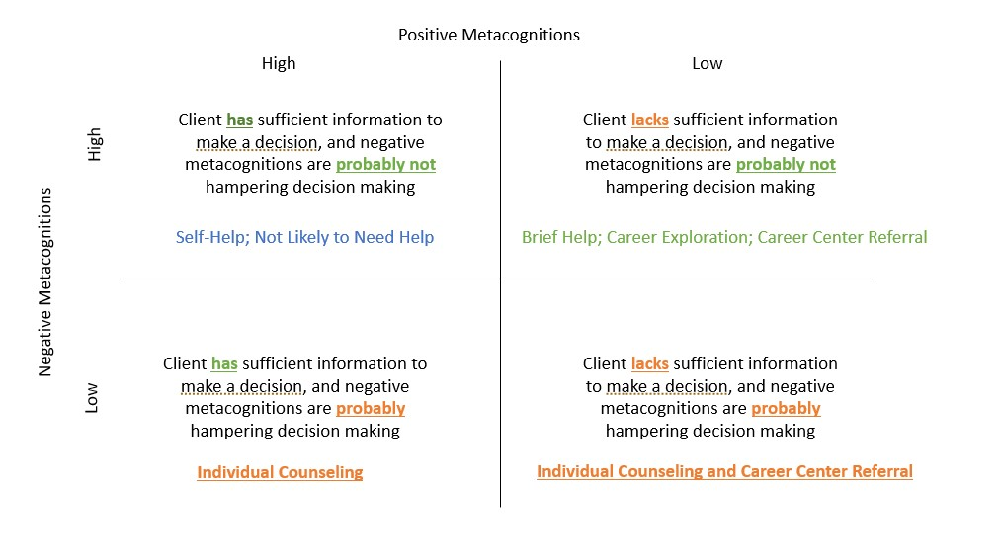
Interpretation & Interventions
Further Assessment
Career Thoughts Inventory
Assess mental health
Career Interventions
Explore discrepancies in COMS
“I have decided/I cannot decide”
CTI Workbook, cognitive restructuring
Self-Efficacy
Self-assessment to address low self self-knowledge
Caution to monitor for negative self-talk
Create individual action plan
Don’t overload
Referral to Individual Counseling, Career Center (depends on what discussion reveals)
Notes:
Gauge

Slide 34
Future Directions for the COMS
Norming Studies
Intervention studies
Usefulness for monitoring client progress
Cross-cultural studies
Different client groups (e.g., high school students, unemployed, etc.)
Relationship to other career constructs (e.g., indecision, CTI)
Relationship to mental health constructs (e.g., for anxiety, depression)
Continue to determine psychometric properties

Slide 35
For further information
Michael Morgan, doctoral candidate, Florida State University
MJM18J@my.fsu.edu
Deb Osborn, professor, Florida State University
dosborn@fsu.edu

