Slide 1

Chapter 1
Introduction to
Career Planning

Slide 2

Presentation Overview
History of “career” – past and present
Key definitions
A sample of career theories
Cognitive information processing
(CIP) theory

Slide 3
Historical Review
Emergence of “career”
Industrial revolution
Immigration
Hazards of early work
environments

Slide 4
Vocational Guidance
Frank Parsons’ Vocations Bureau
Parsons’ 3-step model
  self-assessment
  study of options
  careful reasoning
Lifelong process

Slide 5
Career Planning Today
Rapid change
Nature of work in today’s
organizations
Work options
Diversity
Gender roles at work and home
Career materials and resources

Slide 6
Why Are Career Problems Important?
Economic impact
Impact of full employment on
“health” of a nation
Relation between unemployment
and social and physical problems
Impact of organizational failures
Numbers of people impacted

Slide 7
Some Definitions
career development
career
work
occupation
position
job

Slide 8
Key Definitions Exercise
career development
career
work
occupation
position
job
Volunteering at the animal shelter
Includes all factors that shape your current situation
Accountant
My interview was successful,
and I got the _________.
Microsoft has an opening for
a Technical Trainer
Right now, you are in your __________.

Slide 9
Roe’s Formula
Occupational Choice =
S[(eE + bB + cC) +(fF, mM)) + (lL + aA) + (pP x gG x tT x iI)]
S = sex
E = state of the economy
B = family background/ethnicity
C = chance
F = friends, peers
M = marital situation
L = general learning & education
A = special acquired skills
P = physical characteristics
G = cognitive or special natural abilities
T = temperament/personality
I = interests/values

Slide 10
Which of Roe’s 12 characteristics do you think is most important?
Why?
1)
2)
3)
4)
5)
6)
7)
8)
9)
10)
11)
12)

Slide 11
Theories of Career Choice and Development
Why learn about career theories?
How can they help us?
Personal Career Theory (PCT)

Slide 12
Theories of Career Choice and Development
Structured Theories
(point-in-time; what to choose)
Process Theories
(developmental; how to choose)

Slide 13
Structured Theory Examples
Parsons
Holland

Slide 14
Process Theory Example
Super’s Life Career Rainbow- Nine Life Roles
child
student
leisurite
citizen
worker
pensioner
spouse/partner
homemaker
parent
How many of these roles are you playing right now?

Slide 15
Cognitive Information
Processing Theory (CIP)
Based on how we think & process information
Depends on knowledge structures stored in our
memories
Key aim: help individuals learn to make career
decisions

Slide 16
Characteristics of Career Problems
Involve a gap
Complex and involve feelings
Multiple options, not a single
correct choice
Uncertainty about the outcome
Decisions create new problems

Slide 17
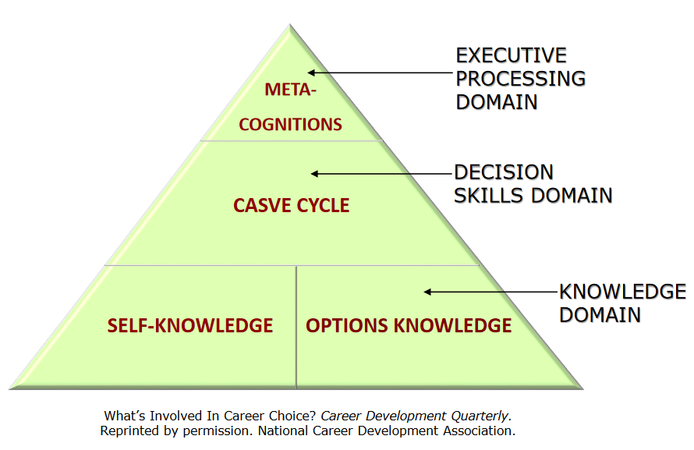
Information Processing Pyramid

Slide 18
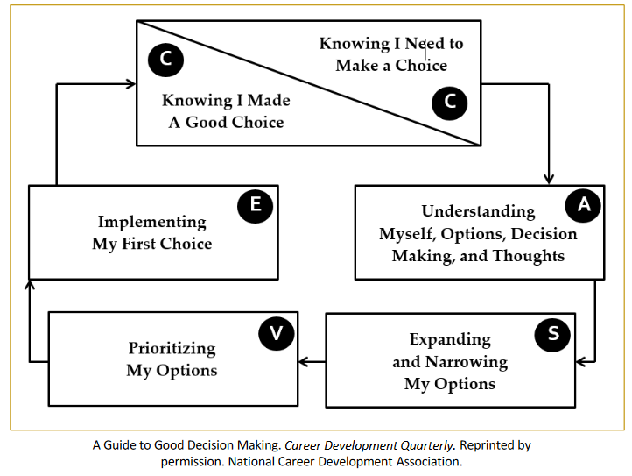
CASVE Cycle

Slide 19
Summary
Impact of social forces on career
development
Importance of career problems
Views of career choice & development
Cognitive information processing
(CIP) theory

